Slide 1
The NHS Central Commercial Function service offer
28 October 2022 at 13:30
Speakers: Jacqui Rock Chief Commercial Officer at NHS England
Chair – Ian Turner - deputy chief executive and director of finance – HFMA

Slide 2
Central Commercial Function
HFMA webinar with
Jacqui Rock
Chief Commercial Officer
28th October 2022
Improving the value from every pound spent
Working as a community to deliver commercial excellence across the NHS

Slide 3
Commercial teams are operating in a changing and complex environment

Slide 4
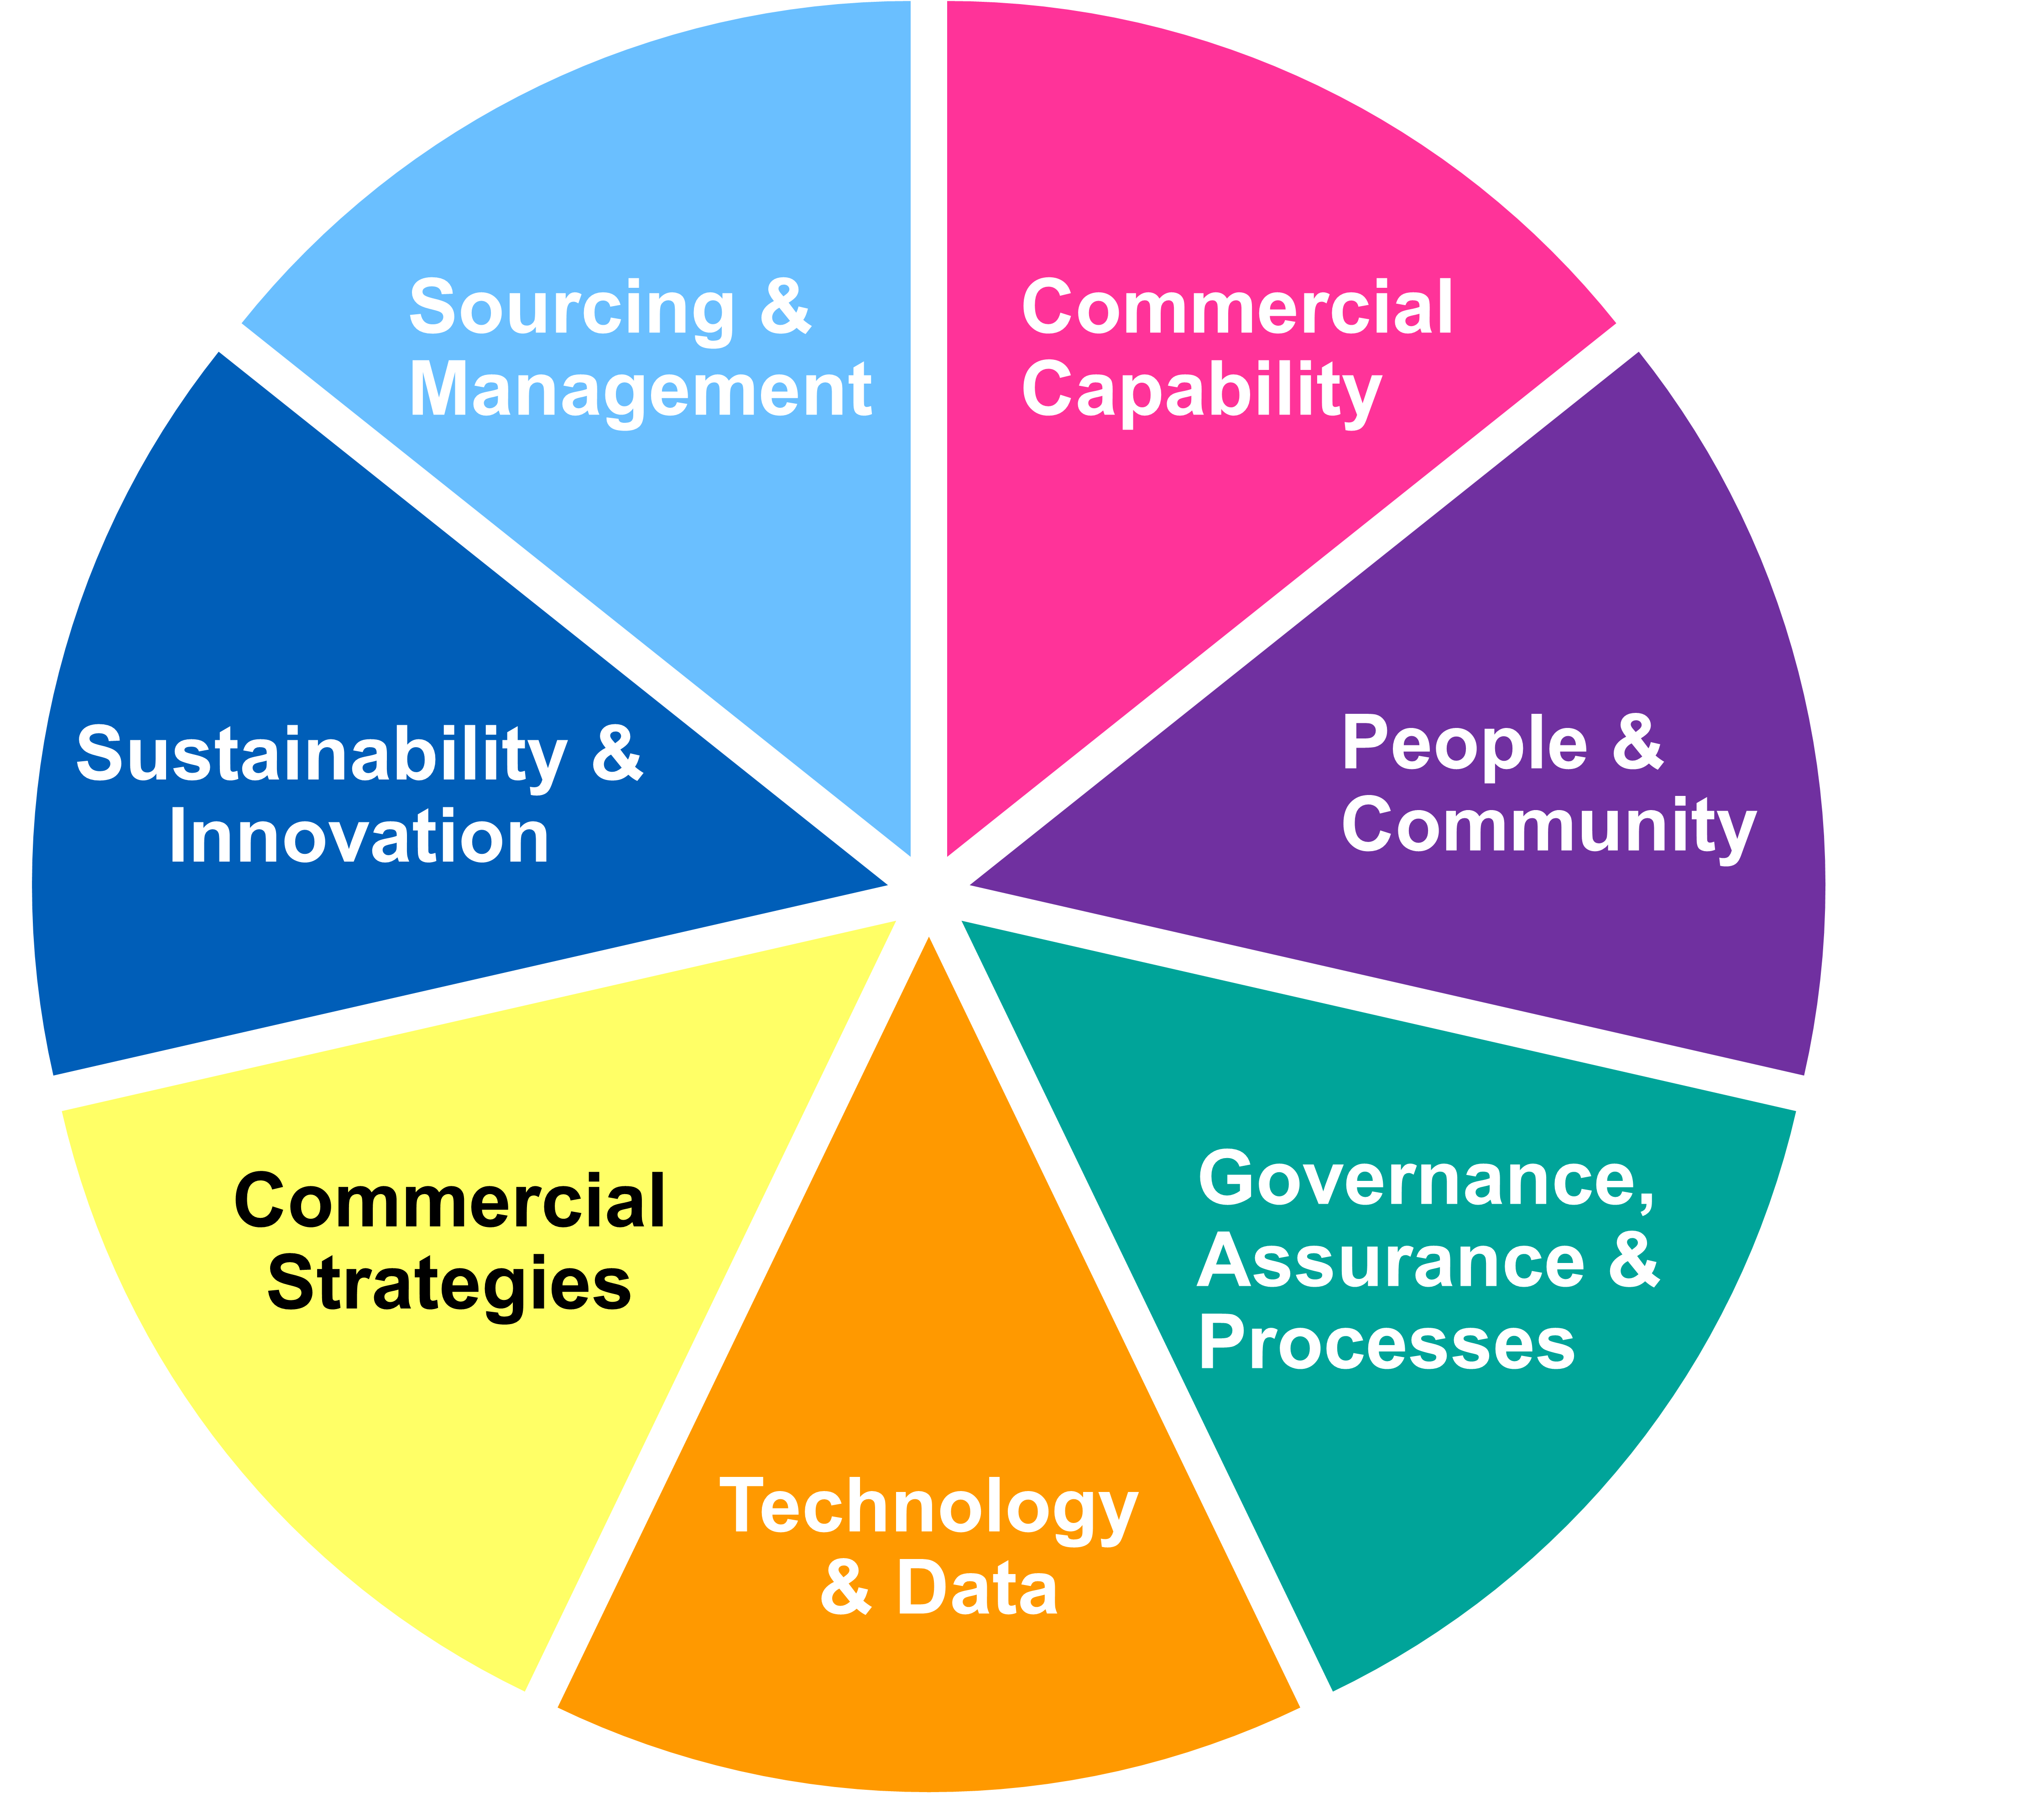
The NHS Central Commercial Function (NHS CCF) establishes a service offering made up of seven elements, which will deliver measurable benefits
Developing a strategic partnership approach that leverages the NHS buying power, shapes the market, drives innovation and resilience within the NHS
Enabling the NHS Commercial community to access tools, expertise and cutting-edge knowledge to deliver purchasing activities at every level of the NHS
Developing an NHS-wide approach to delivering net zero and social value, driving innovation and eradicating modern slavery in the supply chain, enabling stakeholder engagement and application
Embedding a unified community of procurement and commercial specialists who strive to deliver and uphold the NHS Commercial Strategy ensuring best value for money
Creating universal strategy across the NHS with clear commercial activities and routes to market that facilitates ease of doing business
Endorsed, standardised and compliance assured routes to market that wield NHS influence and promote innovation to deliver government priorities
Developing and adopting technology that provides the NHS with insight into procurement value and savings opportunities and outcomes. This will help us to leverage, rationalise and shape the market

Slide 5
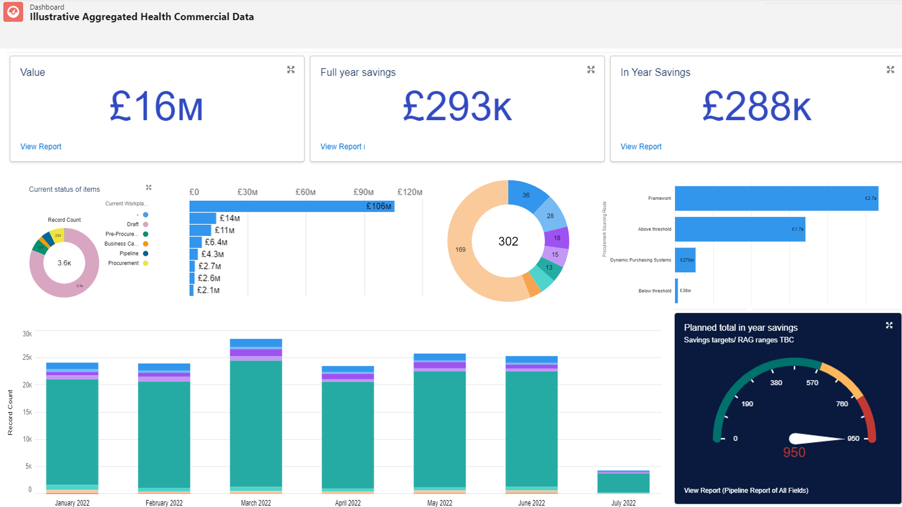
Technology & Data
Developing and adopting technology that provides the NHS with insight into procurement value and savings opportunities and outcomes. This will help us to leverage, rationalise and shape the market
What are the benefits?
Visibility into expenditure (Accounts Payable and Purchase Order), nationally normalised and accessible on a commercial data warehouse, providing the foundation for identifying price variation, common spend and rationalisation potential
Visibility into forecast procurement activity and contracted spend, combined with supplier intelligence, enabling us to better inform resourcing and identify value and savings
For us
Able to get a more competitively priced deal that meets their needs, with (financially) sustainable suppliers through assured routes to market and an ability to manage supplier contracts online
For our end user customers
Understand our future opportunities and how we go to market, enabling them to shape the best possible service offer
Single commercial system to bid through and maintain Evergreen status to demonstrate alignment to NHS Net Zero Supplier Roadmap
For industry
Healthcare services are delivered on time and to the best quality with the best value
For the general public

Slide 6
Commercial Strategies
Creating universal strategy across the NHS with clear commercial activities and routes to market that facilitates ease of doing business
What are the benefits?
Strategy is aligned across the NHS and is all-encompassing, providing clear direction on our priorities and the immediate actions required to deliver our ambition
Commercial strategy will act as the driving force behind governance & approval decisions, clarifying the mapping between contracting decision-making and strategy is clear.
For us
Improved VFM and savings achieved through leveraging increased buying power via category strategies
For our end user customers
Understand NHS priorities and commercial approaches, making it easier to do business and develop positive working relationships
For industry
Effective commercial approaches help ensure healthcare services are delivered at the right time, to the best quality with the best value
For the general public

Slide 7
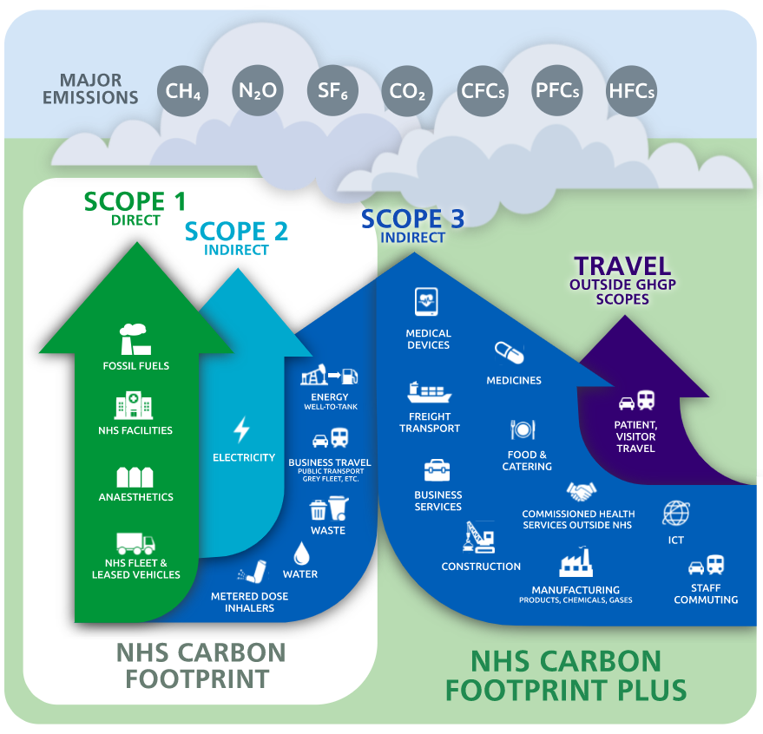
Sustainability & Innovation
Developing an NHS-wide approach to delivering net zero and social value, driving innovation and eradicating modern slavery in the supply chain, enabling stakeholder engagement and application
What are the benefits?
The Net Zero Supplier Roadmap clearly articulates the NHS ambition and establishes consistent, measurable supplier asks
Use of How-To Guides will make it easier to scale and deliver sustainable products and innovative commercial approaches
For us
Improved service from suppliers through use of innovative large-scale contracts
For our end user customers
Understand our priorities, and what we expect from them, so they can better shape their service offer
Evergreen Supplier Assessment will provide a single and consistent way of reporting on Sustainability and Modern Slavery via Atamis
For industry
They have confidence that the NHS is playing an active part in creating a more sustainable world, alongside delivering world-class healthcare services
For the general public

Slide 8
People & Community
Embedding a unified community of procurement and commercial specialists who strive to deliver and uphold the NHS Commercial Strategy ensuring best value for money
What are the benefits?
NHS-wide standardisation of roles, competencies and training
Personal development support for individuals and team development guidance for leaders
Collaboration across NHS Procurement Community will facilitate knowledge sharing and retention
For us
Knowledge retention means that contracts are effectively managed over their lifecycle, ensuring the goods and services the NHS need, are delivered on time and to the correct standards
For our end user customers
Creating a competent and resilient workforce, future proofing skills and abilities to serve the community and procurement functions
For industry
Securing the best clinical outcomes for healthcare service provision, delivered on time and to best value
For the general public

Slide 9
Stay connected
Visit the Central Commercial Function (CCF) web pages
Subscribe to receive our monthly CCF Bulletin
Join the CCF Hub on FutureNHS
Follow NHS CCF on LinkedIn
Email us at england.ccf@nhs.net

