Slide 1
The Velindre Virtually Assessed Patient Clinic
17th February 2023 at 13:30
Speakers: Tej Quine, Advanced Nurse Practitioner at Velindre Cancer Centre and Michael Stone, Service Improvement and Costing Accountant at Velindre University NHS Trust
Chair: Derek Lindsay, Director of Finance at NHS Ayrshire and Arran

Slide 2
Proactive management of service capacity and workforce in oncology clinics: The VAP clinic. A Velindre Cancer Centre example
Tej Quine RGN BSc MSc
SACT Service Development Manager, Advanced Nurse Practitioner, Independent Prescriber,
Breast Oncology Unit, Velindre Cancer Centre, Cardiff, Wales

Slide 3
What is the VAP clinic (Virtually Assessed Patient)
VAP Clinic was set up in Jan 2020 – Pre Covid
Telephone (or video) pre SACT/ chemo assessment clinic
Stand alone nurse prescriber led.
Breast / CRC / gynaecology /urology / CUP
Breast SACT Oral capecitabine – adjuvant/metastatic
KADCYLA® (trastuzumab emtansine) – adjuvant/metastatic
ENHERTU®q (trastuzumab deruxtecan)
Suitable patients top sliced off the consultant/NMP clinics and transferred into the VAP Clinic

Slide 4
Why set up a virtually assessed patient (VAP) Clinic
Out of necessity to address an ever increasing problem with capacity
Over-pressured SACT service struggling to meet the demand
Significant prescriber shortage

Slide 5
Logistics of VAP
5 x all-day clinics a week
SACT nurses / pharmacy technicians / pharmacist NMP in training plus admin
>6,500 patients assessed in the past 2 and a half years
3,500 hours of medical outpatient clinic time saved
Staff training, SACT passport and VAP training/ supervision.

Slide 6
VAP Clinic pathways Parallel(CDK / cape) Transfer care (Adjuvant Kadcyla / cape )

Slide 7
The VAP assessment
Complete a clinically robust checklist on each patient
Bloods
Investigations between SACTs
Tumour markers / scans
Contact with the treatment helpline
Toxicity assessment / grades
New meds from GP/OTT - potential interactions with SACT,
Weight changes
Any other / comments
Next appointment / blood forms
Check date and time of SACT .

Slide 8
Set-up / clinical governance / monitoring
Set up during COVID – easy passage; however, COVID rules no longer apply
Project management approach.
SOPs / risk assessments
Data collection –
Refers (any late adopters/ heavy referrers )
Side effects >Grade 1
Percentage deferrals / dose reductions – benchmark
Incident monitoring. Failure to declare toxicity
Patient/staff satisfaction

Slide 9
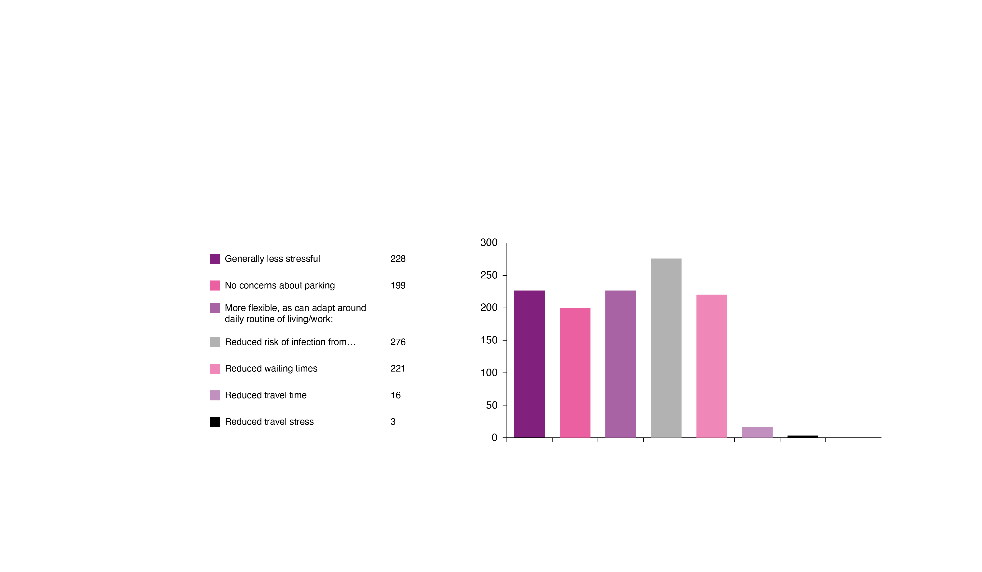

Slide 10
VAP Evaluation
Enabled clinical prioritisation – allowing consultant/NMP expertise to be concentrated on those patients whose needs are the greatest
Reduced the disruption to patients’ lives by using virtual assessments
Improved patient flow by de-coupling clinic days to SACT administration days
Reduced the need for parking spaces / outpatient space
Helped reduce the growth in the size of consultant clinics reducing staff stress
Enabled social distancing during covid times.

Slide 11
Horizon scanning
Expand VAP (increase referrals from existing cancer sites)
New oncology sites (UGI/lung/ CUP )
Develop and trial the VAP app for smart phones

Slide 12
Velindre Cancer Centre Virtually Assessed Patient Clinic
Finance Perspective
Michael Stone
Service Improvement and Costing Accountant

Slide 13
Challenges for Service
Significant year on year growth (~7% p.a. pre Covid)

Slide 14
Challenges for Service
Substantial differences in demand on different days of the week due to patterns of prescribing.
Limited physical space, both for Pre-assessment reviews and SACT delivery.
Significant challenges in recruiting additional oncologists and other prescribers.

Slide 15
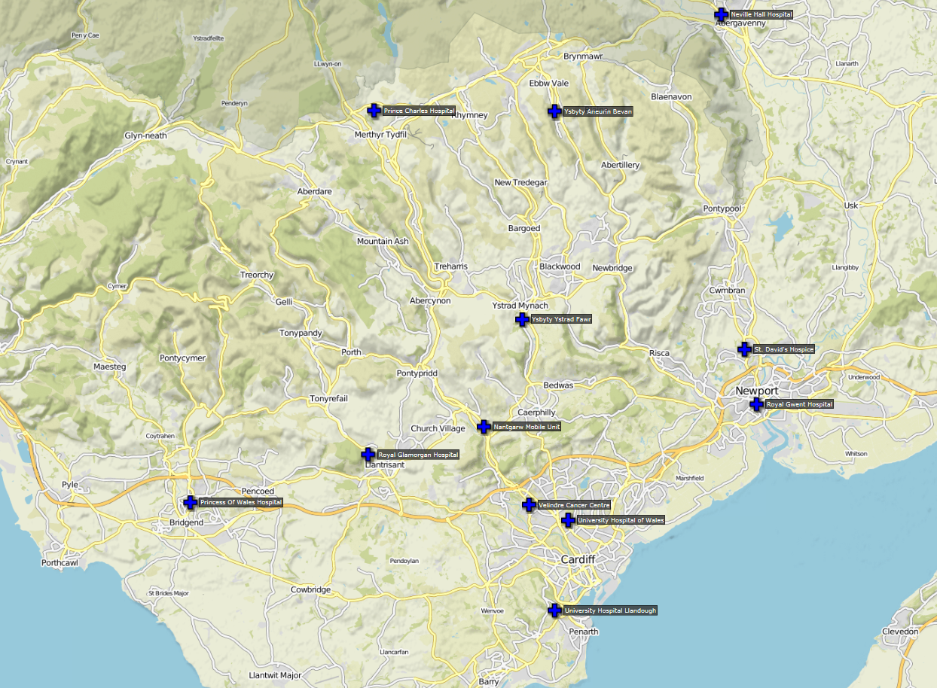
Key Enablers
Builds on existing models of care closer to home such as outreach clinics and homecare services, which included access to phlebotomy and blood testing locally.

Slide 16
Key Enablers
Integrated systems, e.g. blood test results available on Welsh Clinical Portal regardless if bloods taken at Velindre Cancer Centre, or Local Health Board sites.
Digital records including SACT prescribing and outpatient clinical notes.
Access to transformation funds to trial service.
Wales outpatient data definitions recognise independent prescribers.
Bespoke tariff arrangements developed for Velindre Cancer Centre as commissioned tertiary centre, with blended tariff model. Activity based funding based on outpatient consultation type (SACT Assessment) rather than staff type ensures service is financially sustainable.

Slide 17
Impact of Virtually Assessed Patient Clinic
Improved use of SACT capacity, significant reductions in variation in demand on different days of the week, and enabling service to increase capacity despite constraints.
Supported ongoing access to treatment despite 21% increase in SACT treatment activity since 2019/20.
Over 50% direct pay cost savings per consultation compared to traditional staffing model.
Different case mix, and not suitable for all patients.
Existing outpatient services already performed well on financial benchmarks.

Slide 18
Next Steps
Scaling up the service, increasing the number of site specific teams supported and the range of SACT treatments reviewed.
Trial of Smartphone App based assessment (See on Symptoms model of care)
Ties in with wider outpatient transformation developments taking place across the NHS in Wales.
Falls out of existing funding model and data definitions, need to agree non-recurrent funding sources for initial pilot.
Should pilot be successful, aim to agree gainshare with commissioning health boards, where further savings are passed on to wider health economy but the clinical time required to monitor patients is still recognised and funded.

Slide 19
Any Questions

