Slide 1
HFMA Webinar
12th October 2022

Slide 2
Introductions
Tracey Cotterill
MD Population Health Intelligence, Civica
David Wilson
Lead Infrastructure and Connectivity Architect, NHS England
Simon Evans
Head of Cloud and Customer Services, Civica
Ahammad Abdulrahman
Senior Business Analyst, NHS England

Slide 3
NHSE Context
NHSE not here to promote one supplier over another, but grateful to Civica for inviting us to join this webinar. It is an opportunity for us to provide information on our current thinking on cloud and understand in more detail the challenges faced by organisations in cloud adoption
We see cloud adoption as more than a technical activity and several of the challenges relate to the financial changes adoption requires
We don’t see cloud as the only option going forward but currently believe it’s not being evaluated fairly against alternatives - this is not due to any prejudice more a lack of experience.

Slide 4
Agenda
Welcome and Introductions
IT Costs in the NHS
Guidance on Cloud Strategy
Developing your Cloud Strategy
Challenges and Benefits of Cloud
Next Steps
Q&A
Close

Slide 5
IT Expenditure Analysis
NHS spend on IT

Slide 6
Global Economic Context
In pre-cloud, pre-digital transformation days, IT budgets only went up when the economy was good and went down when the economy was bad. IT was perceived more as a cost centre than a strategic resource with the potential to increase the top line
IT spending went up during the lockdowns, but indications are that in 2022 it has reduced from the peak
Around 39% of European companies report that they now have at least half of their applications in the cloud, up from 24% in 2020
Across Europe there is a reduction in capital spending as a percent of total IT expenditure as companies have moved to the cloud and subscription models
The transition to cloud is most likely when legacy systems are due for replacement – most industries have a cloud first policy
Health has complex datasets and strict IT security and privacy requirements. The sector requires IT staff with sector-specific skills in dealing with patient medical records systems, mobile platforms, and imaging and other clinical systems with large data storage and networking requirements.
Further, health bodies also support many users who are not employees.
Even given these complications, the Health sector typically spends far less on IT as a percentage of revenue, and less per head than other industries.
Source: Computer Economics Inc – European IT Spending & Staffing Benchmarks

Slide 7
Overarching Statistics
Key Data
For financial year (FY) 2020 – 21 (unless specified)
219
£151bn
£1.82bn
Trusts
NHS England and NHS Improvement revenue budget
Total healthcare ICT spend
Across 42 Integrated Care Systems
The total amount of revenue spending power available to the NHS for FY2022-23
Excluding spending on ICT staff
42
5.4%
2.7m
Integrated Care Systems
Change in core spending
FTEs*
Number of authorities with social care responsibilities
The proportion core spending power has risen in real-terms between FY2010-11 and FY2020-21
Working across the NHS and social care
Source: GlobalData, June 2022. *Full-time equivalent.

Slide 8
Hardware spend – by org type and category of spend
Source: https://publicsector.globaldata.com/sector/marketdata/4500008/mda

Slide 9
Software spend – by org type and category of spend
Source: https://publicsector.globaldata.com/sector/marketdata/4500008/mda

Slide 10
Services spend – by org type and category of spend
Source: https://publicsector.globaldata.com/sector/marketdata/4500008/mda

Slide 11
Overall spend by category and by region
The previous tables show spend by sector but that hides any distribution within a sector.
It is also worth noting that many acute trusts host procurement services across wider geographies or through frameworks which may skew the data somewhat
The table on the left clearly demonstrates the variation in spend across different categories with vertical specific applications accounting for almost a third of the overall total.
The table to the right shows the spend by region and we can see large variation between regions but again this may be skewed by hosted procurement services purchasing on behalf of other regions
Source: https://publicsector.globaldata.com/sector/marketdata/4500008/mda

Slide 12
Guidance on Cloud strategy
What are the options

Slide 13
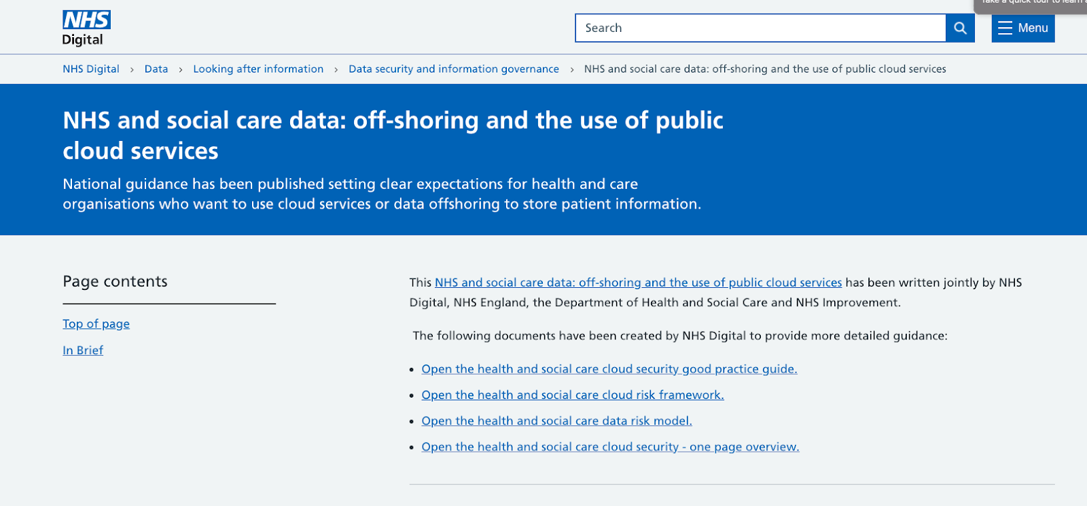
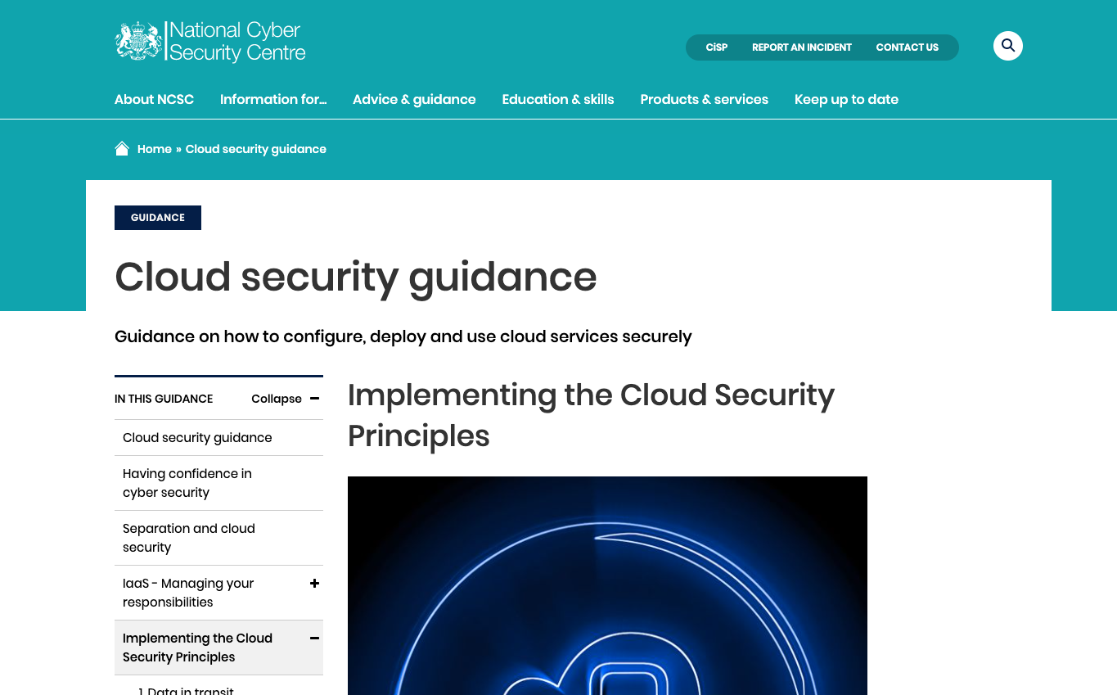
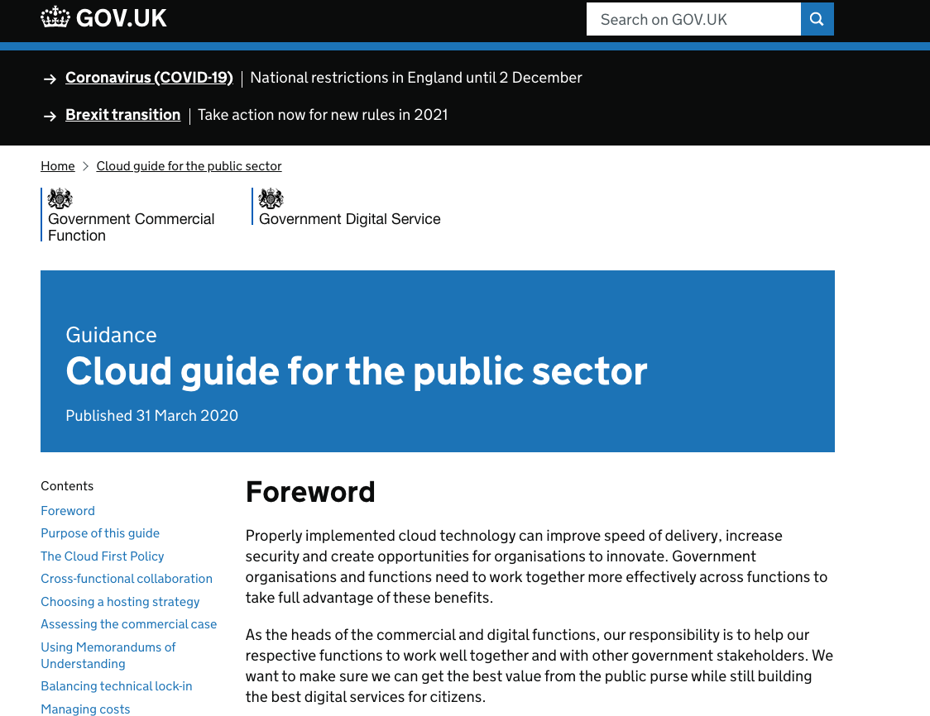
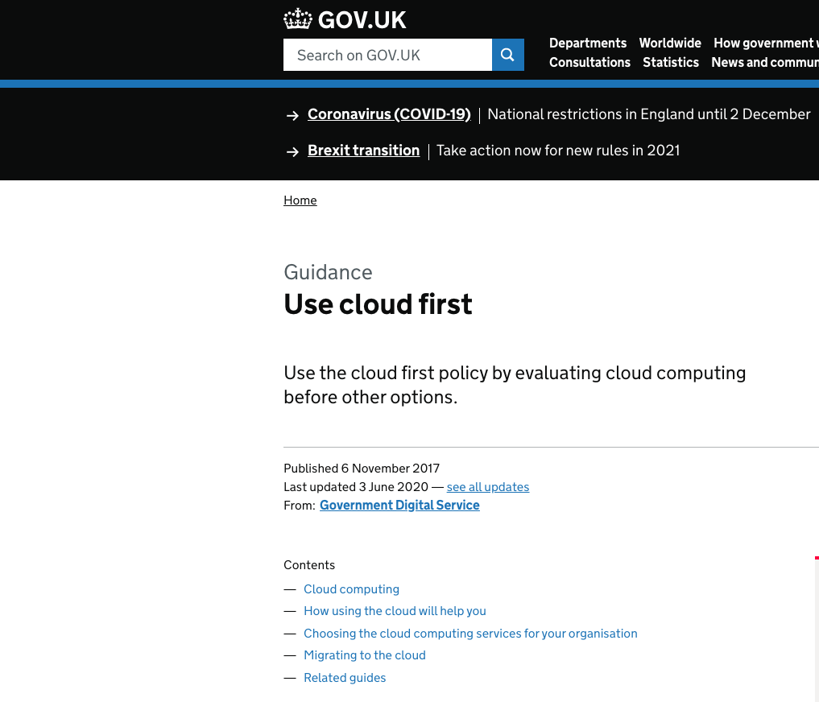
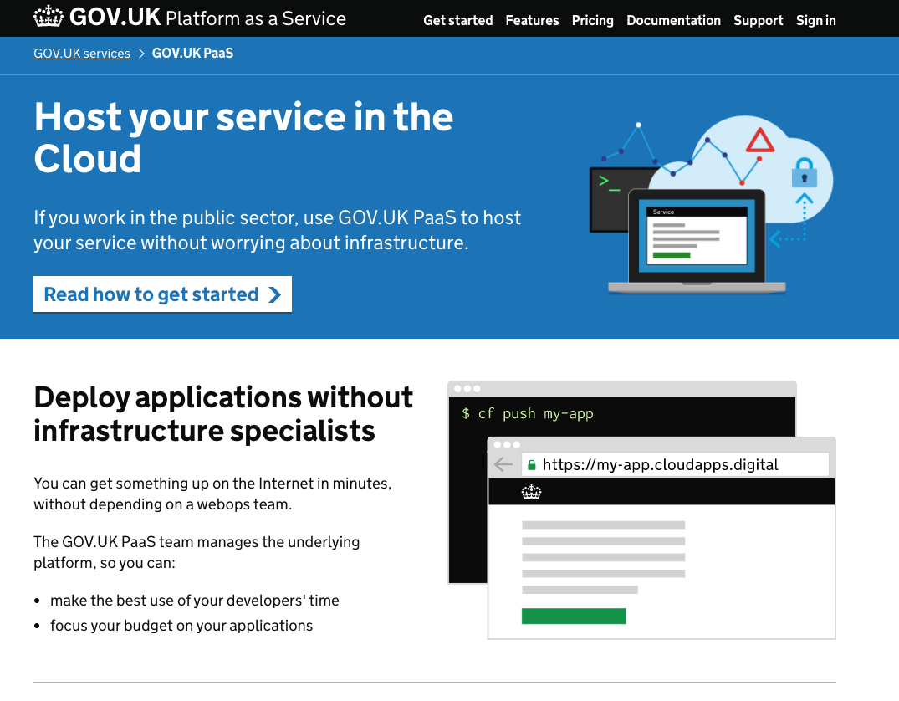
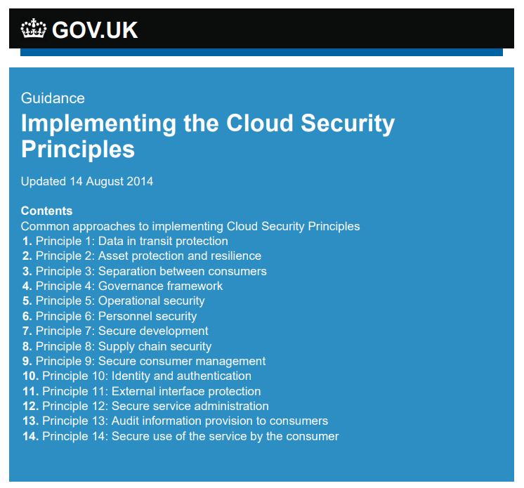
Abundance of existing guidance

Slide 14
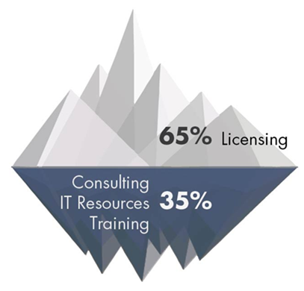
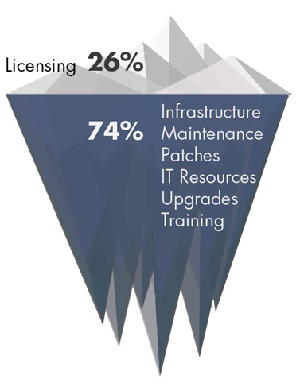
How is cloud different than on premise?
On-Premise
Cloud
Iceberg model
Transferring responsibility
20-30%
70-80%
70-80%
20-30%
HIGHER
Total cost of ownership for customer
LOWER
LOW
Share of customer IT spend with Cloud Software Vendor
HIGH

Slide 15
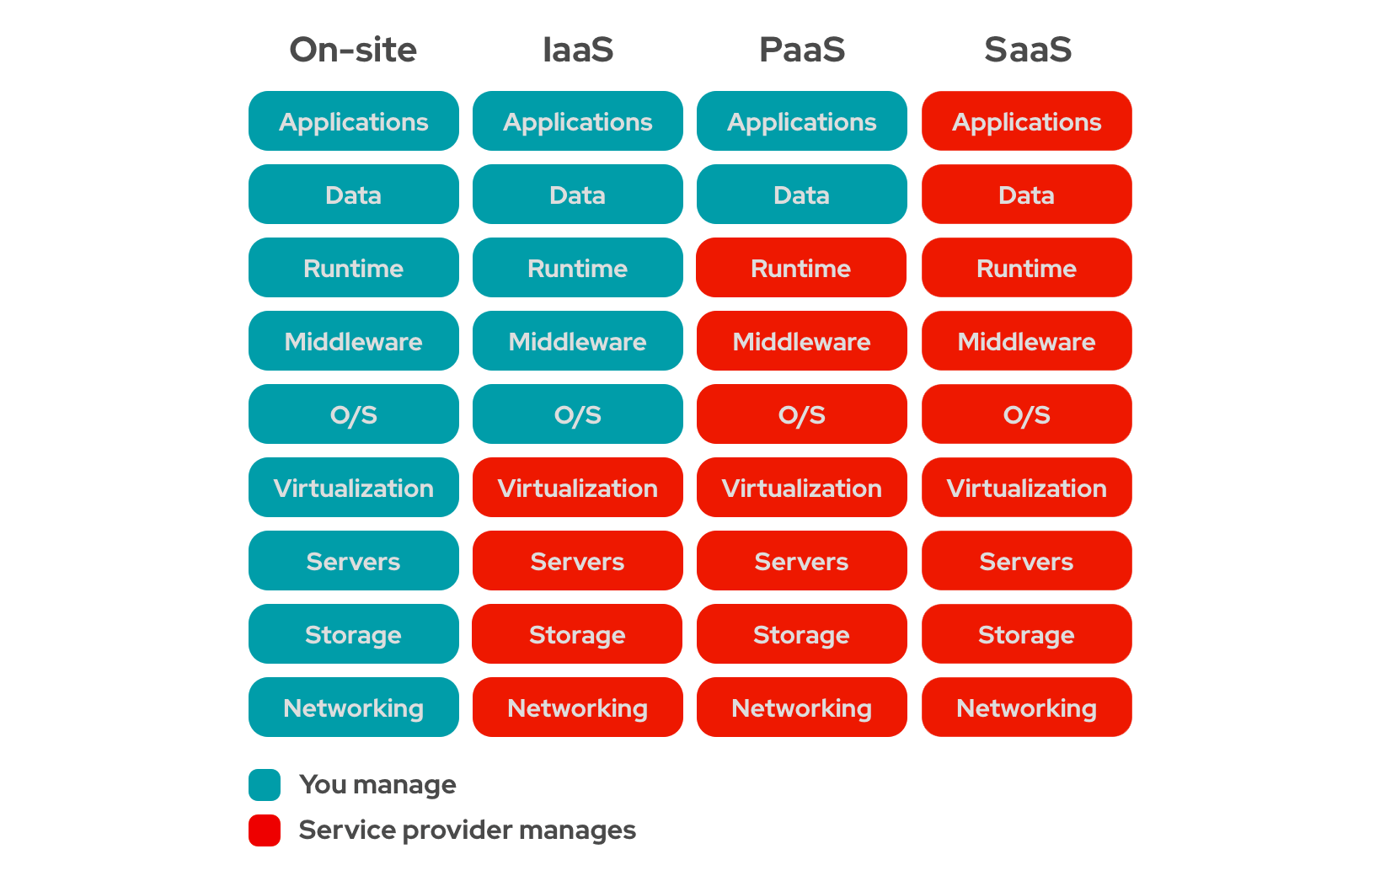
Cloud isn’t just one thing
Sliding scale cost against responsibility as provider takes more responsibility contract negotiation and understanding the mechanisms for monitoring and impacting performance becomes more critical.

Slide 16
IT Estate Audit

Slide 17
Audit the IT Estate
First thing to do is to look at your estate and decide which is the best solution for each application:
Some applications are not and cannot be cloud solutions – either leave on prem or buy a new application
Some applications are available in a cloud ready version but require some adaptation which may have cost implications and require changes for end users
Some applications are cloud ready with no adaptation required
Some applications may already be hosted in the cloud.
When looking at the Estate’s suitability for the cloud, consideration should also be given to how the applications operate in the cloud:
Cloud Native – built explicitly to take advantages of the capabilities of cloud
Cloud enabled – applications built for traditional deployment but migrated to the cloud. Some changes made but the fundamental structure of the applications remains the same.
Source: Computer Economics Inc – European IT Spending & Staffing Benchmarks

Slide 18
Migration Options
Application Suitability | Migration option | Rationale
Not Cloud suitable | Leave application as-is | Retaining the application until it is due to be renewed or temporary park and review later.
Not Cloud suitable | Replace application with cloud suitable alternative | Repurchasing an alternative solution that is either SaaS or Cloud suitable
Supports Cloud | Migrate as-is | Use business criticality and complexity as criteria to decide when to migrate (rehost)
Requires changes for Cloud | Invest in changes and migrate | Depending on the scale of the changes required this might be as simple as some small tweaks (replatform) or require more substantial time for major changes (rearchitect)
Requires changes for cloud | Treat as a “not cloud suitable” application | If the complexity/effort is high for Cloud support, one of the other approaches to remove the complexities maybe a better fit.
Found to be a duplicate | Remove all but one duplicate | In the process to identify how to migrate applications it is possible (and likely) to find applications which duplicate each-other. In this case identify the one(s) which best meet the business objectives and retire the others

Slide 19
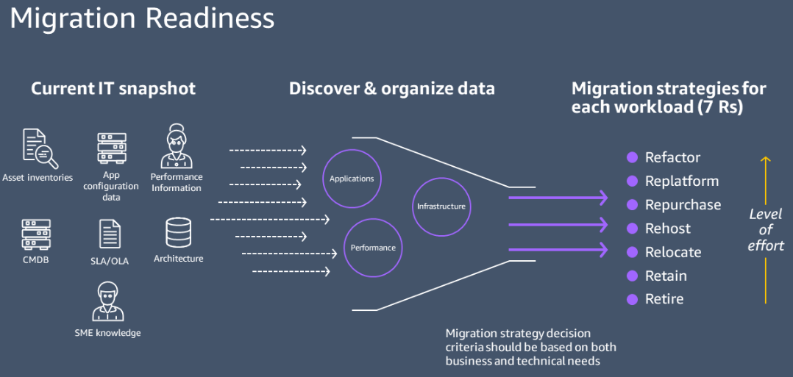
What is cloud suitable? How do we get started?
Cloud benefits

Slide 20
Challenges and benefits of cloud
Overview

Slide 21
What are the challenges and benefits of Cloud?
Capital to revenue funding
Lacking a clear strategy determined by business objectives
Lacking Technical skills to manage integrations
Consumption based model may lead to variable costs instead of fixed costs – but this can be managed through the contract
Contractual management skills needed
Financial management
Getting the tender right to reduce risk. Ensuring the provider meets all the needs/risk – tender process
Set the right KPIs to monitor ongoing compliance
Risks eg Resilience & Availability, Aged Infrastructure
Governance & Security
Data Integration
Agile working
Cloud reduces your carbon footprint.

Slide 22
Challenges
Comparing the Costs

Slide 23
Cost Considerations Building the financial case
The bullets below give some examples of areas for consideration within the business case over and above Return on Investment, but there will be more.
Capital v Revenue considerations
Depreciation of current IT estate – possible nbv write offs
Staff costs to manage IT estate – including backups, upgrades, patches etc
Physical estate cost – including energy
Cyber security and Disaster recovery costs
Risk of aged IT infrastructure – financial, operational and reputational
True cost of on-prem – including what should be being done but isn’t being.
The financial case will no doubt have a range of options through from do nothing to full cloud migration with varying degrees of cloud adoption in the options
The starting point for the financial case is the Audit of the IT Estate. The alternative cost for each application will need to be considered within the financial case. When determining the suitability for cloud, the audit should capture the cost of transition for each application.

Slide 24
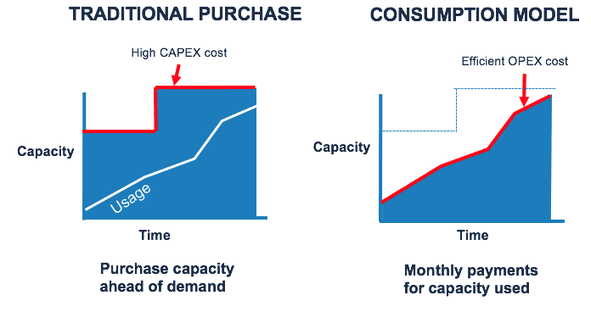
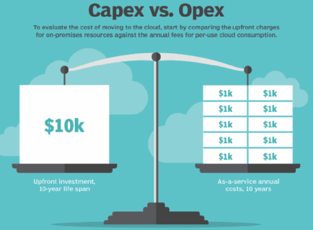
Consumption based

Slide 25
Cloud cost management
The FinOps Foundation’s requirements for cloud cost management
Inform |  | Optimise |  | Operate
Understand fully loaded cost | Performance benchmarking | Real-time decision-making | Predict, plan and purchase capacity | IT, finance and LoB collaboration
Visibility into IT spend | Trending and variance analysis | Find and remove underutilised services | Rightsize instances and services | Finance moves at the speed of IT
Granular cost allocation | Internal team benchmarking | Understand if resources are under or over-provisioned | Cenralised RI buying process | Continuously improve for efficiency and innovation
Team-level budgets and tracking | Industry peer-level benchmarking | Automation of resources | Compare pricing | Defined governance and controls for cloud usage

Slide 26
Challenges
Transition to vendor management

Slide 27
Vendor Management
Understand and be able to monitor vendor against SLAs in contract
Managing risk – security and compliance; if vendor has an issue its still your organization that suffers reputational damage
Managing costs – understand cost model used by vendor and penalties that can be applied – this works well when it’s seen as a partnership – pick partners carefully
Right size the requirements – the higher the spec the higher the cost, and less vendors will be able to meet the specifications.
Information Monitoring
Multi-system Integration
Enhanced visibility
Preferred vendor list
Third Party Risk Management

Slide 28
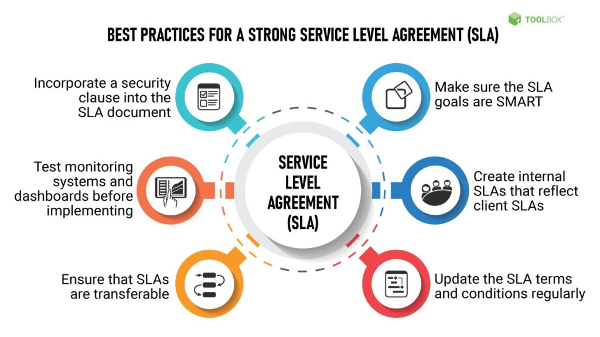
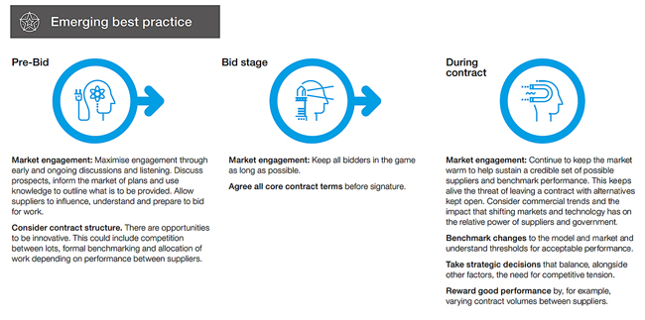
Vendor Management
As solutions move to SaaS vendors the quality of the service is managed more by the details of the contract rather than input from on-site technical teams
Contract negotiation is the start of the process
Need to be meeting with 3rd party regularly throughout contract and reviewing progress against key indicators which should help measure performance against the service level agreement
Monitor the vendors performance independently – where they have an obligation that you can’t easily validate (say backup) ensure tests are performed you can validate
Managing risk – security and compliance; if vendor has an issue its still your organization that suffers reputational damage
Managing costs – understand cost model used by vendor and penalties that can be applied – this works well when its seen as a partnership – pick partners carefully
SaaS adoption requires input from technology to assess and guide especially when it comes to security and business continuity

Slide 29
Benefits
Overview

Slide 30
Cloud delivers you more peace of mind, value and sustainable innovation…
82%
800+
24h
80%
65%
of local government staff worked from home (Mar/Jun 20)
attacks every hour on the local government
for NHS to do 13 years of human analysis
Decrease in calls to 111 line after introducing CovidCare NI
of UK citizens aged 70+ use a smartphone daily
Stronger resilience & availability
Advanced security
Better insights & integration
Higher productivity
Faster, sustainable, green innovation
Defined availability
Infinite Capacity
Proactively maintained global/national service
Provider component to DR
Security updates
Specialised support
DDoS protection
Privacy guidelines
Strong Authentication
Insightful reporting
Data linking
Performance
Interoperability
Single Sign On
Upgrades
Streamlined process
Best practice
Better user experience
Automatic updates
Chatbots
Advanced Analytics
Mobile, ID Verif.
AI
Fixed capacity
Long lead times
Maintenance burden
Power challenges
Security competes with other priorities
Multiple vendors with different update polices
Backup/media storage
Point-to-point integrations
Data held in many silos
Connectivity challenges
Staff focus on adding process value
Security updates
Specialised support
DDoS protection

Slide 31
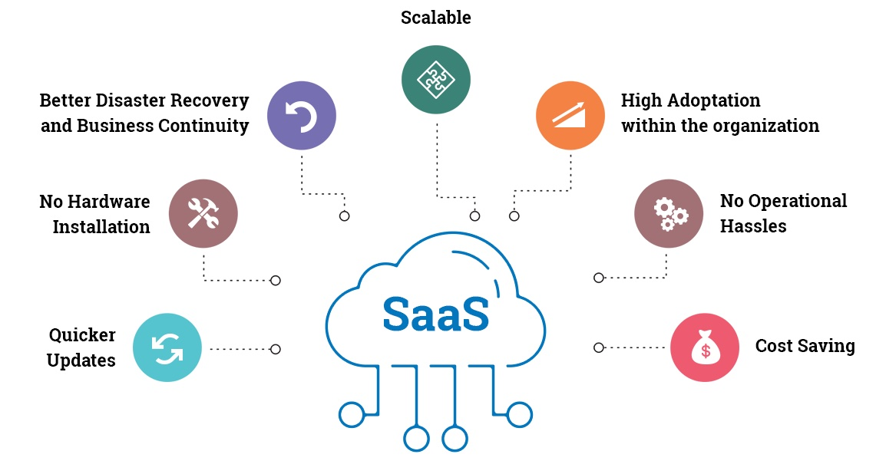
SaaS benefits
Reduced time to benefit
Lower costs
Scalability and Integration
New releases (upgrades)
Ease to use and perform Proof-of-concepts

Slide 32
Cloud delivers you more…
Peace of mind
Value & efficiency
Sustainable
innovation
Stronger resilience & availability
Better insights & integration
Faster, sustainable, green
innovation
Advanced security
Higher productivity

Slide 33
Benefits
Governance & Security

Slide 34
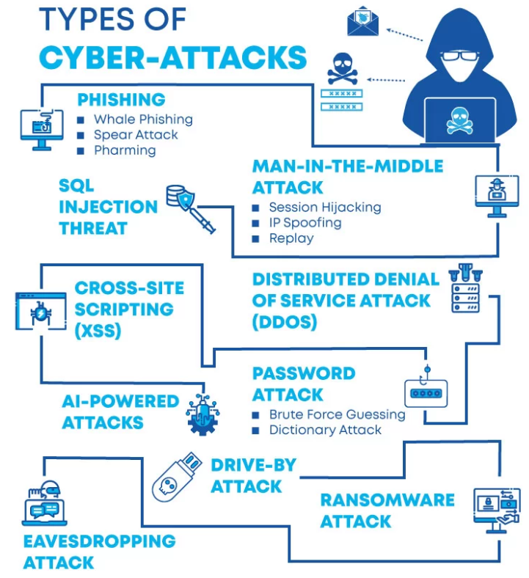
Impact of Cyber Crime
Cyber Attacks becoming more Sophisticated, Targeted, Widespread and Undetected
There is a protentional to be fined by the ICO and is a Board Level concern.
There is a rising cost of Cybersecurity breaches, Reputation Risk and Investment required for Prevention.
Global Cybersecurity market expected to be worth $352.25 billion by 2026 (annual growth of 14.5%)
In Europe, the countries whose firms have the biggest Cybersecurity expenditures are France ($3.1 billion), Spain ($2.6 billion), Germany ($2.2 billion), United Kingdom ($1.5 billion), Netherlands ($1.3 billion), and Belgium ($1.3 billion)
US Cybersecurity workforce totals 942,000 with around 521,000 positions currently unfilled.
Cost of Ransomware damage in 2021 ($20 billion) is 57 times more than the cost in 2015
Organized criminal groups are behind 55% of data breaches.
Healthcare industry receives 2-3 times more cyber attacks than the financial services sector – Cyber attackers can sell medical records on the dark web for up to $1,000 each
The likelihood of detecting and prosecuting the perpetrators of cyberattacks in the US is at a dismal 0.05%
Cyber Crime is BIG business and prosecution rates are low
https://www.digitalhealth.net/2022/08/advanced-major-outage-cyber-attack/

Slide 35
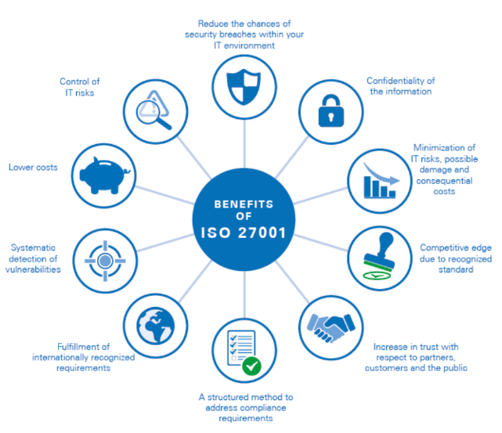
Information Security Certifications
ISO 27001 Benefits
ISO 27001 (ISO/IEC 27001:2013) is the internationally accepted management system standard for Information Security.
The standard is well recognised across the world, ranking as one of the most popular global information security standards. An ISO 27001 certification demonstrates that an organisation can protect their data systems and information assets, keeping them safe and secure.
The certification is a common requirement for contracts with public sector bodies and large organisations and demonstrates to stakeholders that information security is a company priority.
Cyber Essential Benefits
Reassure customers that you are working to secure your IT against cyber attack
Attract new business with the promise you have cyber security measures in place
Have a clear picture of your organisation's cyber security level
Some Government contracts require Cyber Essentials certification
Crest Benefits
CREST is an accreditation body for Security Professionals. It provides organizations with assurance that Security Professionals meet a standard for activities such as Penetration Testing.
Penetration Testing is where companies simulate a cyber attack on their system to test its security.
ISO 27001 – International Standard
Cyber Essentials – UK National Cyber Security Centre
CREST – Accreditation for Security Professionals

Slide 36
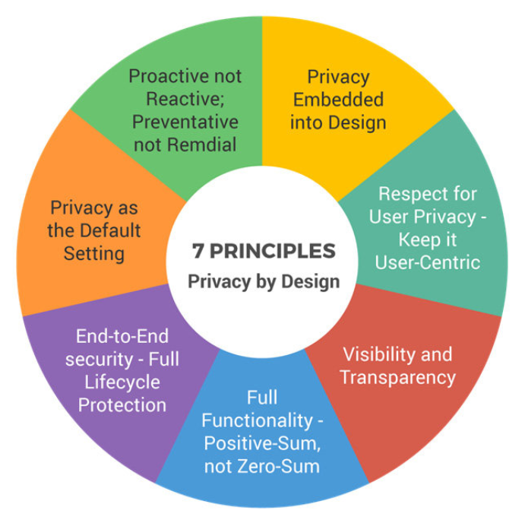
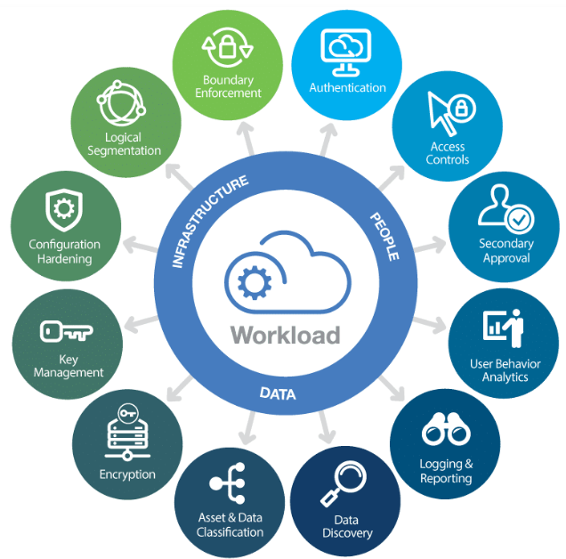
Bid/Tender Process - Information Security
Bid Considerations
Organisations to request information during the bid process for the vendor to describe details on, but not limited to:
Privacy By Design
Described as ‘Data protection through technology design’
Under GDPR, known as Data Protection by Design / Data Protection by Default
Design requirement under GDPR legislation
Cloud Security Safeguards
Describe their Cloud Solution ensuring it meets all business security requirements.
Does their solution use advanced security monitoring tools for automated proactive cybersecurity?
Is their solution regularly Penetration Tested by certified security professionals (CREST approved)?
Privacy, Governance and Accountability Framework
Describe their Privacy, Governance and Accountability Framework
Vendors processes for privacy, risk and security management.
Vendors processes for audit and compliance.
Ensure the vendor can meet all of the security requirements required by the organisation. Also allows vendors to be compared and scored.

Slide 37
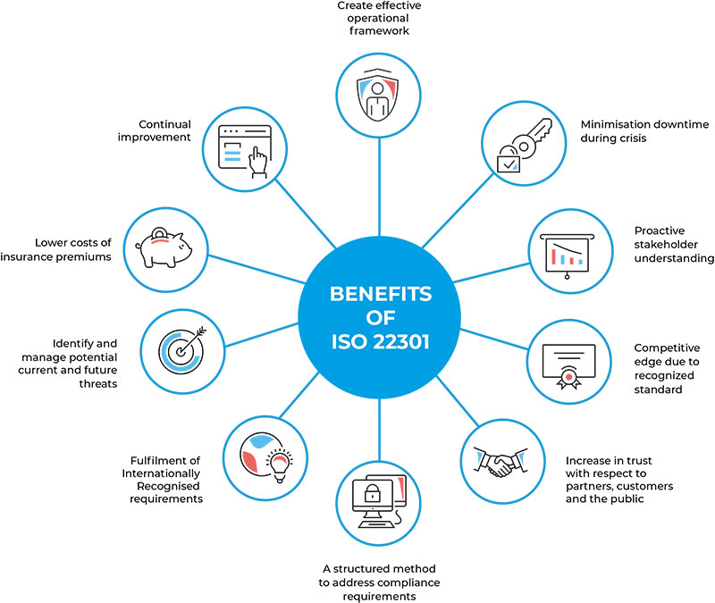
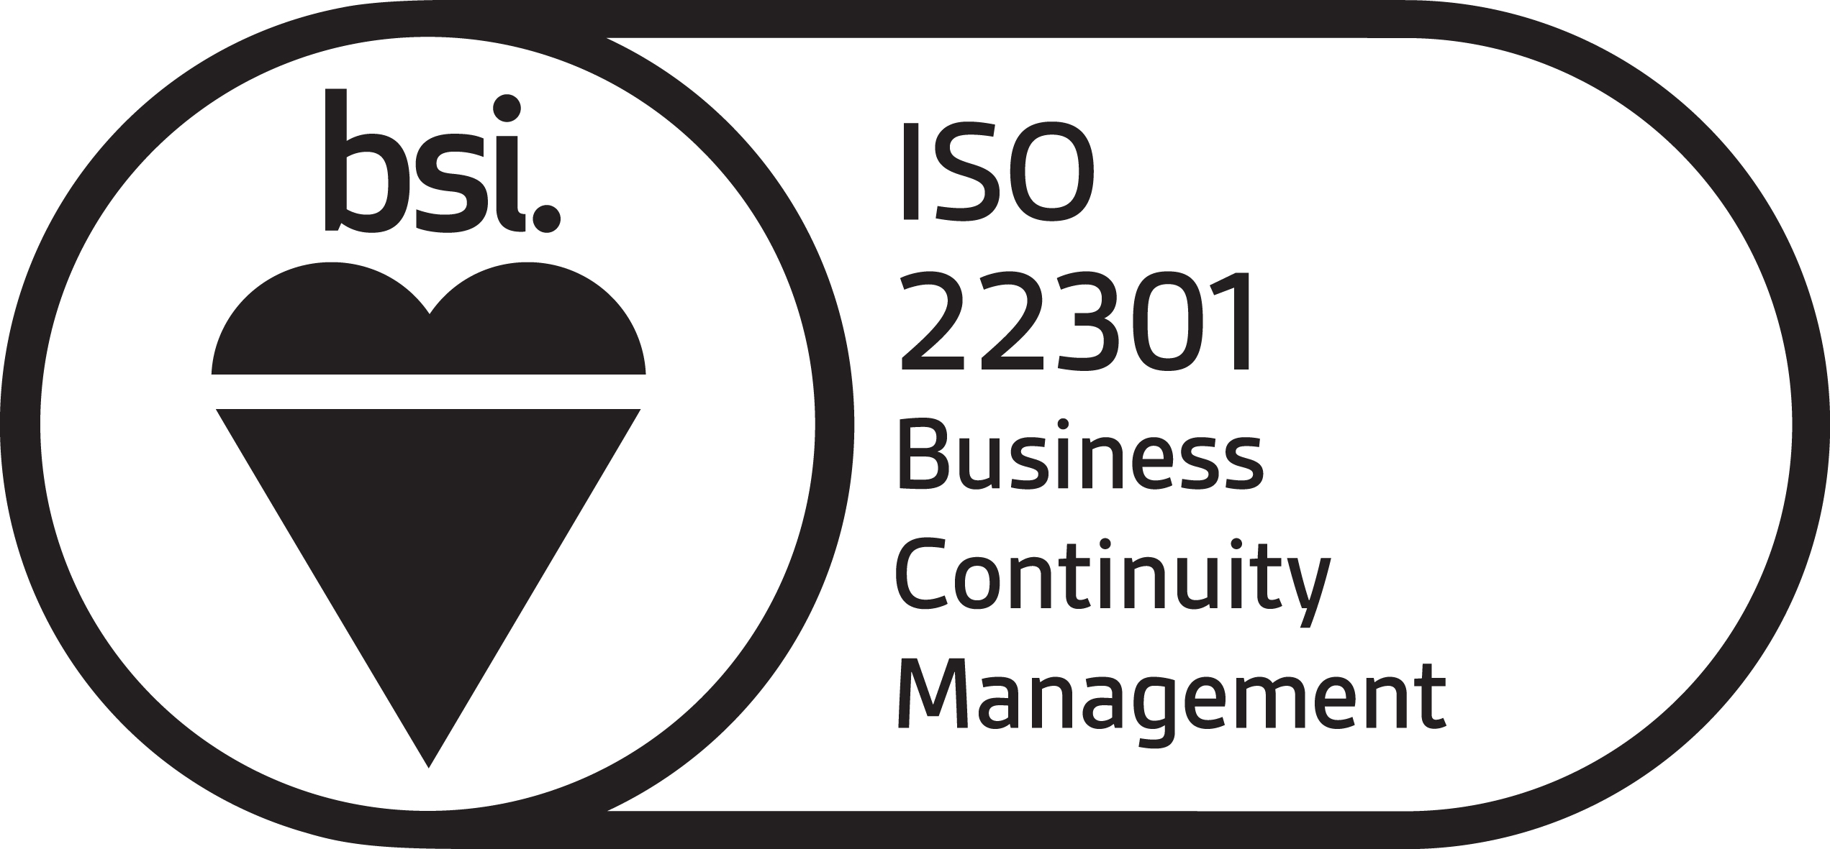
Business Continuity
ISO 22301 Benefits
Internationally accepted management system standard for Business Continuity Management
The standard is well recognised across the world
An ISO 22301 certification demonstrates that an organisation has a practical framework in place for managing an effective business continuity programme
The purpose of the certification is to safeguard an organisation from a wide range of threats and disruption.
Certifications
ISO 22301 – International Standard

Slide 38
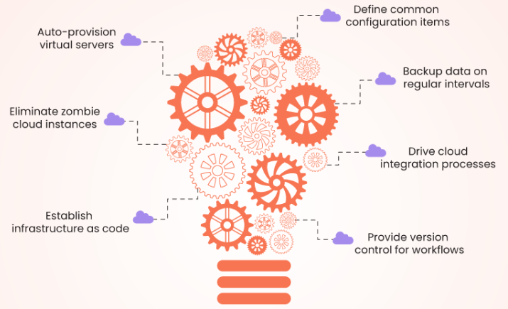
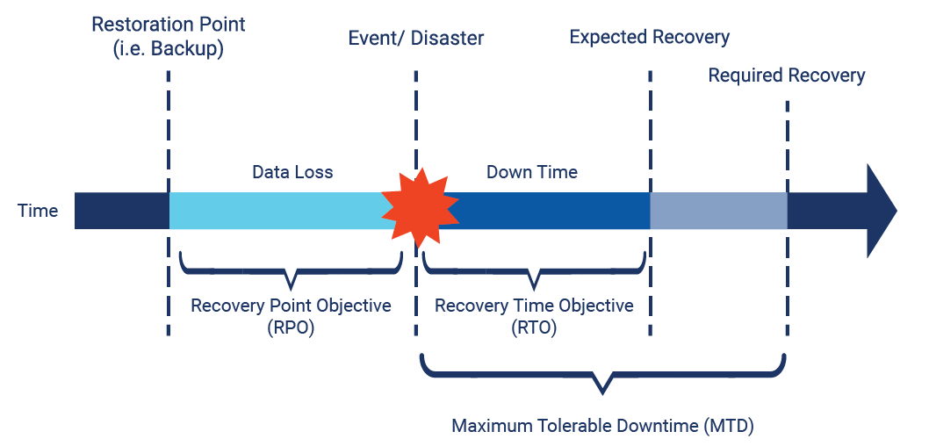
Bid/Tender Process - Business Continuity
Bid Considerations
Organisations to request information during the bid process for the vendor to describe details on, but not limited to:
Cloud Infrastructure Technologies
Are the Cloud environments defined in software? ‘Infrastructure as Code’ can be used to simplify and automate infrastructure redeployment and data recovery.
Is the infrastructure and application software under version control? Improves consistency of environments and enhances security.
Is data backed up regularly/continuously? ‘Point-in-time’ backups can reduce potential data loss. Geo-replicated backups provide additional safeguards against regional disasters.
What is the availability targets for the environments? Are High Availability or PaaS Services used to increase uptime?
Disaster Recovery
What are the expected (RTO) and maximum (MTD) recovery times?.
What is the maximum data loss (RPO) duration / restoration point / data backup frequency?
Ensure the vendor can meet all of the business continuity requirements required by the organisation. Also allows vendors to be compared and scored.

Slide 39
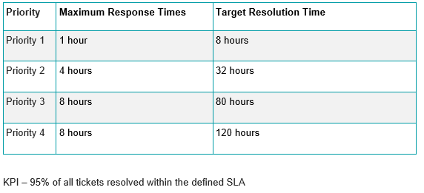
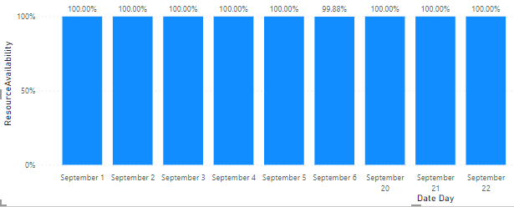
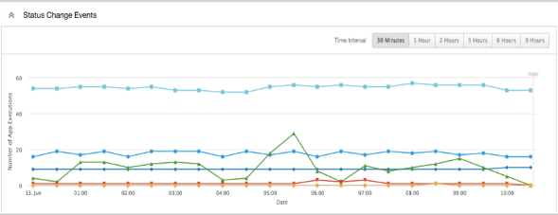
Contractual SLA and KPIs
Support Services SLA and KPIs
ITIL Service Management Framework - one of the most respected in the industry
SLA based on ticket priority. Priority defined by impact and urgency
SLA define response and resolution targets by priority
KPI defines percentage of tickets resolved within SLA
Support Service reports to track performance against the contract.
Availability SLA and KPIs
SLA defined as % availability target System/Application per month
KPI defines number of months SLA missed before financial penalties kick in
Availability Service reports to track availability against the contract.
Performance SLA and KPIs
SLA defines specific performance targets for the application (e.g. data processing time target)
KPI defines number of months SLA missed before financial penalties kick in
Performance reports to track performance against the contract.
Service Reviews and Improvement
Contractual SLA and KPI to be regularly reviewed against contractual targets
Service Improvement Plans if vendor not meeting contractual KPIs
Financial Penalties for poor performance (e.g. Service Credits).

Slide 40
Next Steps

Slide 41
Useful Contacts
David Wilson, Lead Infrastructure and Connectivity Architect, NHS England david.wilson71@nhs.net
Ahammad Abdulrahman, Senior Business Analyst, NHS England ahammad.abdulrahman1@nhs.net
Dean Eyre, Principle Infrastructure Architect, NHS England dean.eyre@nhs.net
Tracey Cotterill, MD Population Health Intelligence, Civica tracey.cotterill@civica.co.uk
Further Reading
Article https://healthcare-digital.com/digital-healthcare/creating-the-digital-hospital-while-keeping-a-healthy-budget
Introduction to FinOps https://www.finops.org/img/resources/Intro-to-FinOps-1-0.pptx
NHS cloud strategy and guidance https://future.nhs.uk/NHSXCloud/grouphome
Cloud First https://www.gov.uk/guidance/government-cloud-first-policy
Cloud guide for the public sector https://www.gov.uk/government/publications/cloud-guide-for-the-public-sector/cloud-guide-for-the-public-sector
Article https://www.techmarketview.com/ukhotviews/archive/2022/10/04/average-uk-business-suffers-44-cyber-attacks-per-year
Article https://www.fm-magazine.com/news/2022/sep/8-steps-finance-leaders-deliver-digital-transformation.html

