Slide 1
N365 – What’s out there?
An overview on the latest apps available for you to utilise and enhance your productivity.
Niamh Szywala – Digital Application Support
Hertfordshire Community NHS Trust

Slide 2
Agenda
MS Bookings
MS Shifts
MS Updates
Asset Booker
Viva Learning
Viva Insights
Power Automate
Digital Hero Community
Additional Apps and Tools
Questions

Slide 3
MS Bookings
Bookings includes a web-based booking page, which integrates with Outlook to optimise your calendar and give your customers the flexibility to book a time that works best for them.
Notes:
https://learn.microsoft.com/en-us/microsoft-365/bookings/bookings-overview?view=o365-worldwide
https://support.nhs.net/knowledge-base/virtual-visits-and-microsoft-bookings/

Slide 4
MS Shifts
Shifts in Microsoft Teams is a schedule management tool that helps you create, update, and manage schedules for your team.
Notes:
https://support.nhs.net/knowledge-base/using-ms-shifts-to-roster-health-and-care-staff/

Slide 5
MS Updates
The Updates app in Microsoft Teams provides a centralised place for members of your organisation to create, review, and submit updates. By creating update requests, you can use the Updates app to keep track of anything your organisation needs.
Notes:
https://learn.microsoft.com/en-us/microsoftteams/manage-updates-app#overview-of-updates

Slide 6
Asset Booker
An application your organisation can use within Microsoft Teams to book assets such as desks, meeting rooms, car parking spaces, pool cars, specialist equipment. You define what and how the assets can be booked.
Notes:
https://support.nhs.net/knowledge-base/digpacks-asset-booker-app/
Asset Booker – may need tweaks to use it how you need (40 desk limit per site)

Slide 7
Viva Learning
Viva Learning is a centralised learning hub in Microsoft Teams that lets you seamlessly integrate learning and building skills into your day. In Viva Learning, your team can discover, share, recommend, and learn from content libraries provided by both your organisation and partners.
Notes:
https://support.nhs.net/knowledge-base/viva-learning-overview/
https://support.nhs.net/knowledge-base/learning-on-microsoft-365/

Slide 8
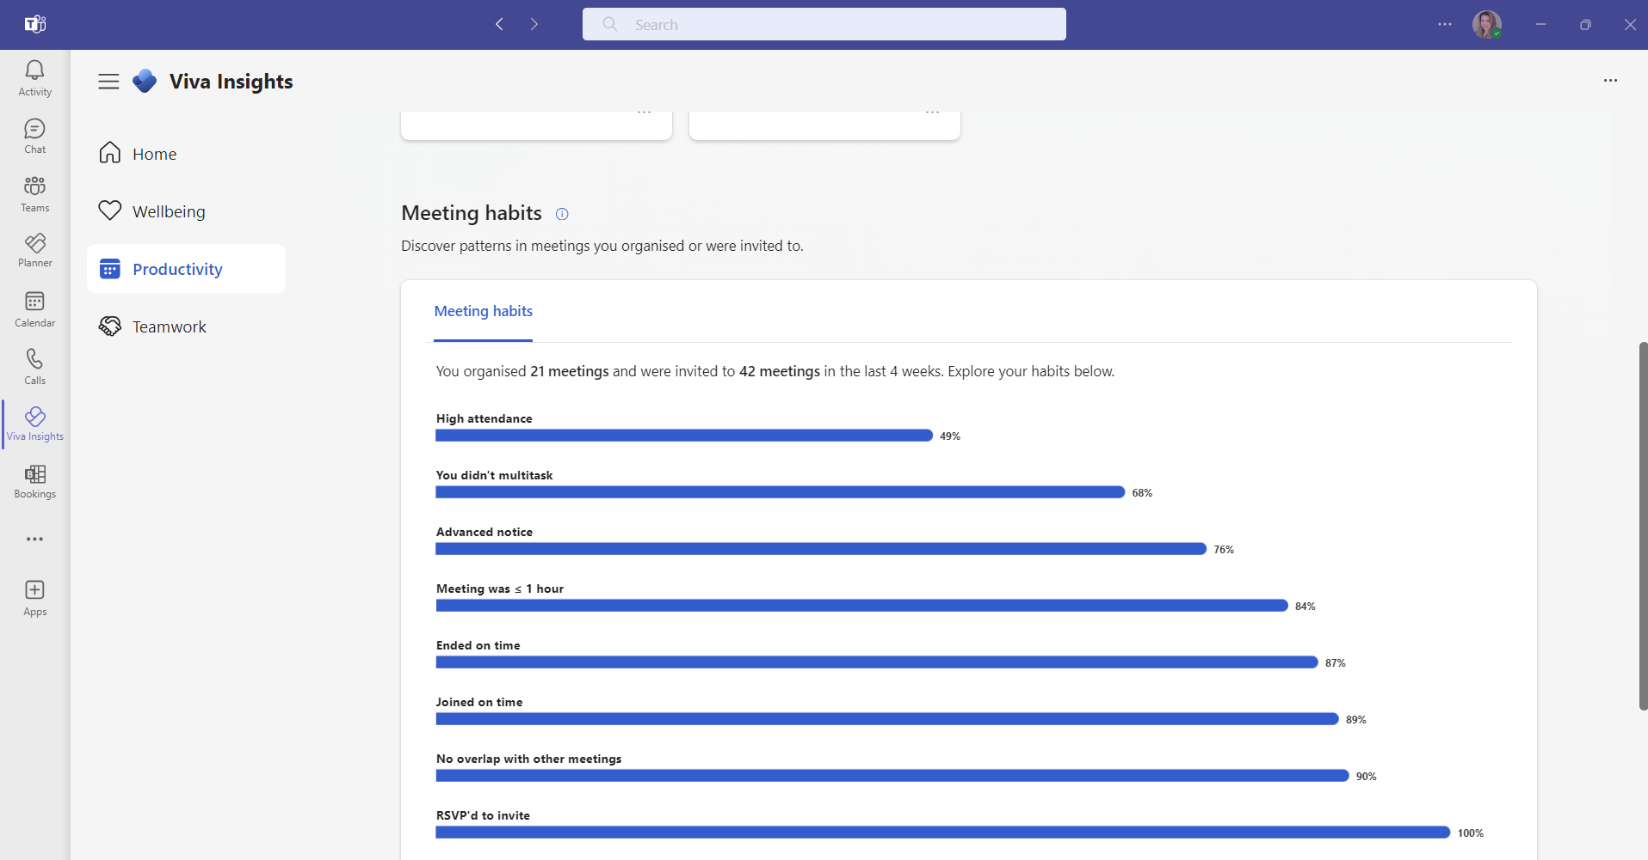
Viva Insights
Viva Insights helps people and businesses thrive with data-driven, privacy-protected insights and offers recommendations to improve productivity and wellbeing.
Notes:
https://learn.microsoft.com/en-us/viva/insights/introduction

Slide 9
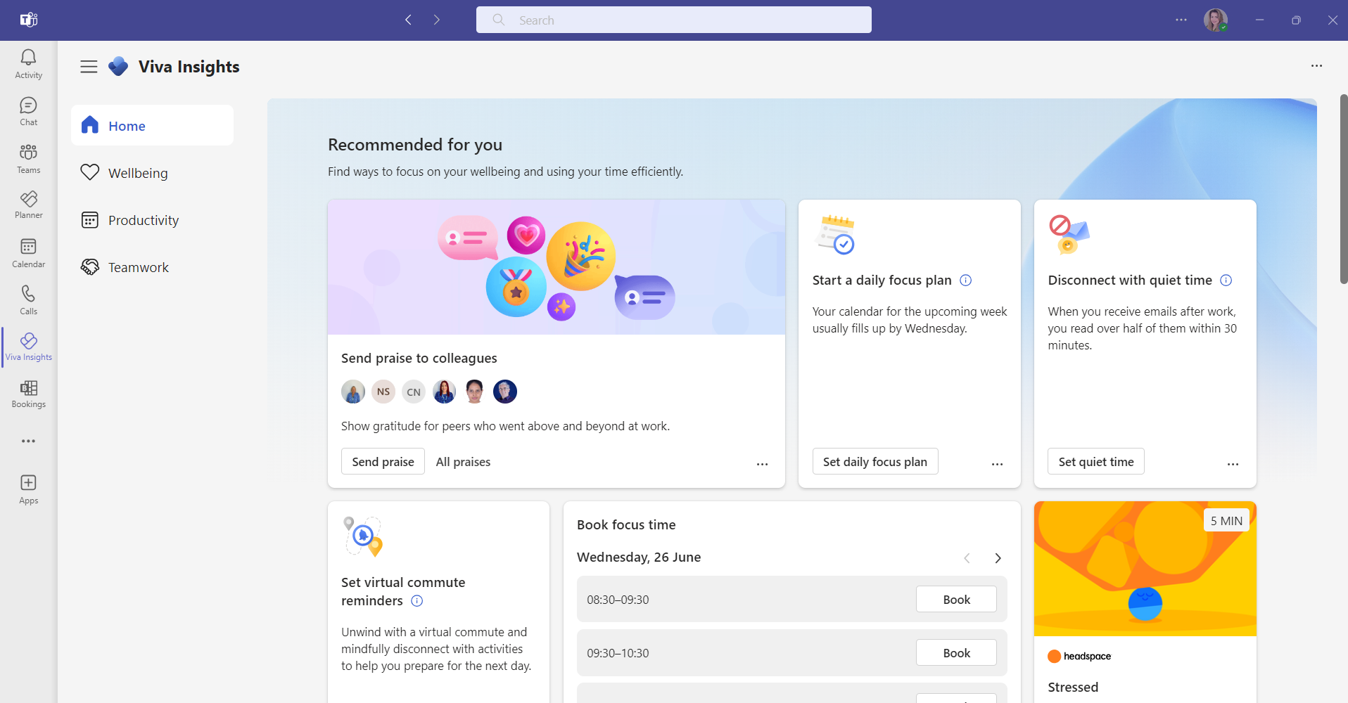
Viva Insights
Viva Insights helps people and businesses thrive with data-driven, privacy-protected insights and offers recommendations to improve productivity and wellbeing.
Notes:
https://learn.microsoft.com/en-us/viva/insights/introduction

Slide 10
Power Automate
Power Automate, previously known as Microsoft Flow, is a cloud-based service designed to automate repetitive and time-consuming tasks. It integrates with various data sources and systems, including Office 365 and Azure. Users can create workflows by defining triggers and actions.
Notes:
https://support.nhs.net/knowledge-base/power-automate/

Slide 11
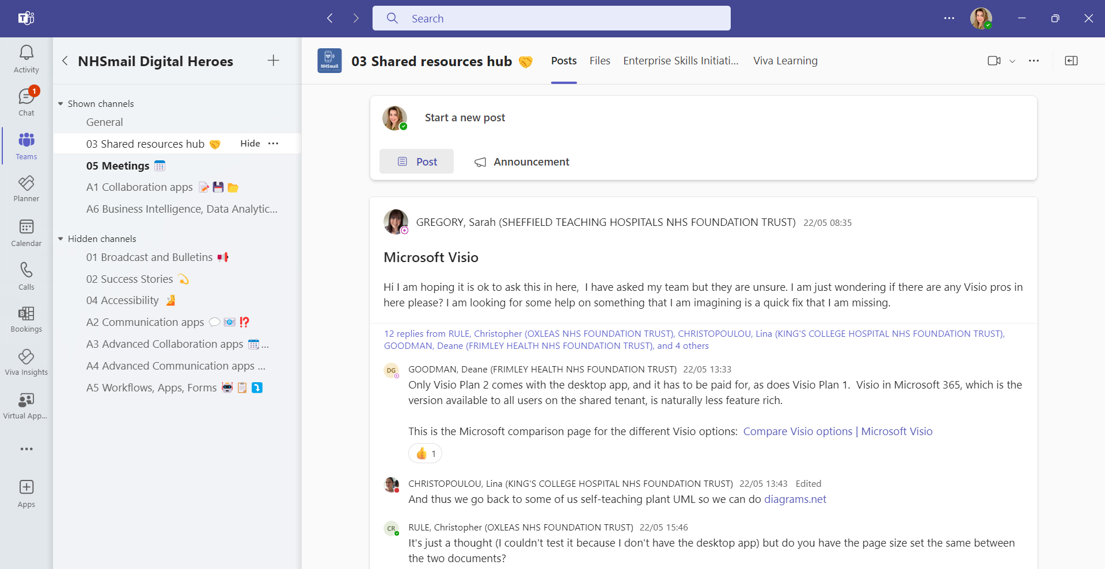
Digital Hero's Community
The NHSmail Digital Hero community is made up of NHS colleagues from across the service. You do not need to possess a set of digital skills and knowledge already, but you must be a passionate digital pioneer. The community will provide you with knowledge, skills and a network of likeminded individuals to help improve the way we all work together.
Notes:
https://support.nhs.net/knowledge-base/digitalhero/

Slide 12
MS Team meeting tools
Q&A
Polls
Whiteboard
Live Captions
PowerPoint Live
Breakout rooms

Slide 13
Additional N365 Applications
Click on the application you would like to learn more about below. Each link will direct you to Microsoft learning portal which provides guides and tips on each product.
Please note some of these features may have limitations due to the N365 Tenancy. Please check with your IT team for more information.
N365 Standard Products Help & Learning
OneNote
Teams
Visio
Forms
To-Do
Planner
Lists

Slide 14
N365 – What’s out there?
Any questions?
Niamh Szywala – Digital Application Support
Hertfordshire Community NHS Trust

