Slide 1
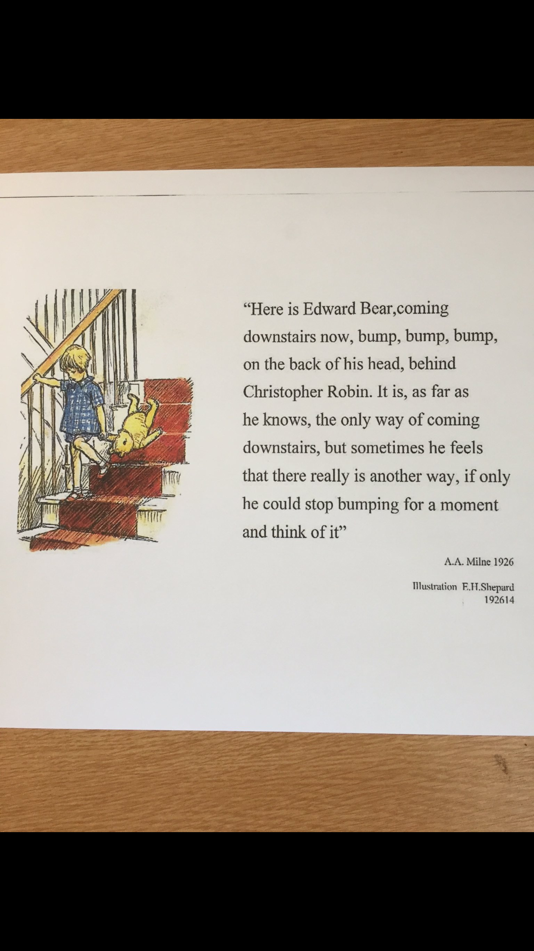

Slide 2
HFMA NI Branch Annual Conference Titanic Belfast Friday 24th November 2023
Raymond Curran
Head of Ophthalmic Services, SPPG

Slide 3
“Strength behind the numbers”
Introduction
Role & Responsibilities
Context
Demand
Demography
Strategic Context
Policy Drivers
Pathways to productivity and efficiency

Slide 4
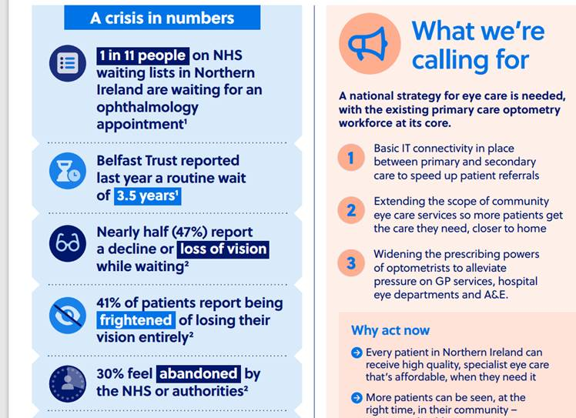

Slide 5
There are many numbers….. One of them is ‘eReferral’ Activity, a very broad measure of “demand”
1.4.22 to 31.3.23 - Overall Activity for Ophthalmology Referrals (Optometrist & GP) Regionally n=34,495
THE
“BIG HITTERS”

Slide 6
Monthly Activity
IPDC: ca. 1,000
Outpatients: 10,000
New: 2,500
Review: 7,500
Opportunities for reform, transformation, modernisation and efficiency.
(GIRFT, PIFU, Enhanced triage).

Slide 7
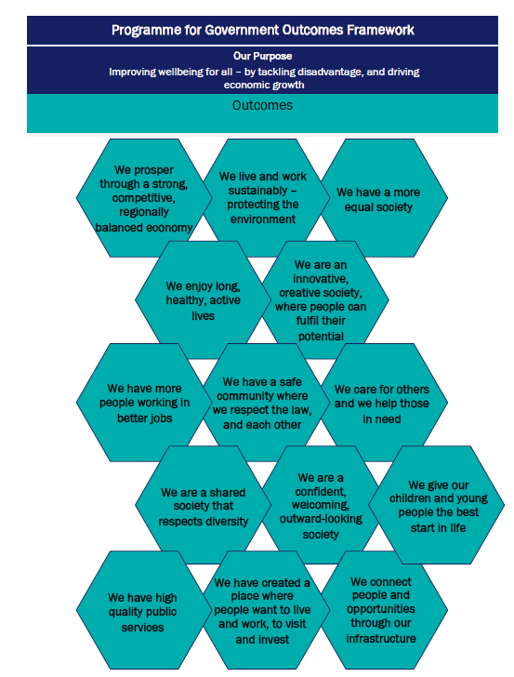
We enjoy long, healthy, independent lives
We care for others and we help those in need
We give our children and young people the best start in life
We have high quality public services

Slide 8
Estimated and projected proportion of population by age mid-2020 and mid-2045 (source: NISRA)

Slide 9
Health and Wellbeing 2026: Delivering Together
A Commitment to:
Establish new models of provision such as regional Elective Care and Treatment Centres - to deliver large volumes of assessments and non-complex routine surgery across a broad range of specialties

Slide 10
Northern Ireland Eye Care Network (NIEN)
Multi-disciplinary
+
Multi-agency
January 2021

Slide 11
THE ‘PATHWAY’ APPROACH Transformation for improved outcomes and results.

Slide 12
What existed was a multitude of pathways and options……with all that this brings
Out Patient Department (OPD)
All of below
Glaucoma Service
G.P
Macular Service
Paediatric
˃
˃
Emergency Department (ED)
˃
Optometrist
Low Vision
Glaucoma/ OHT
˃
Diabetic Eye Screening (DES)
Corneal
Neuro-ophthalmology
Pharmacy
Oculoplastics
Motility
Out of Hours (OOH)
Regional Acute Eye Services (RAES)
Retinal
Uveitis
Acute Eye Pathway Glaucoma/OHT
Cataract Pathway Diabetic Eye Screening/Eye Disease

Slide 13
The “Glaucoma” Care Pathway

Slide 14
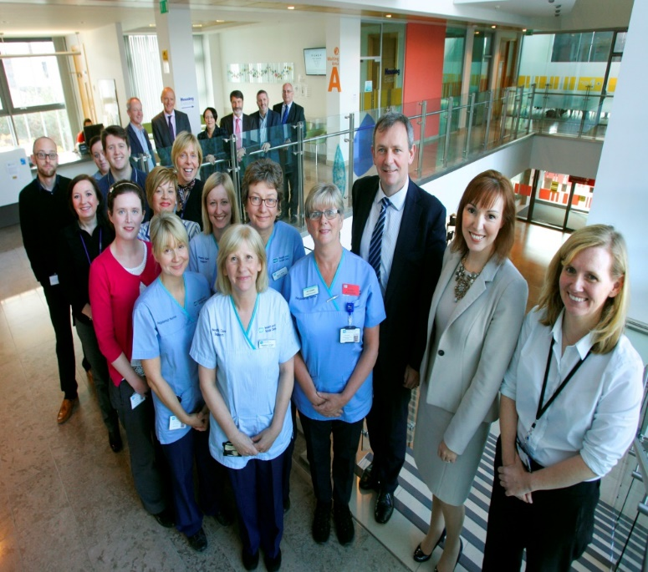
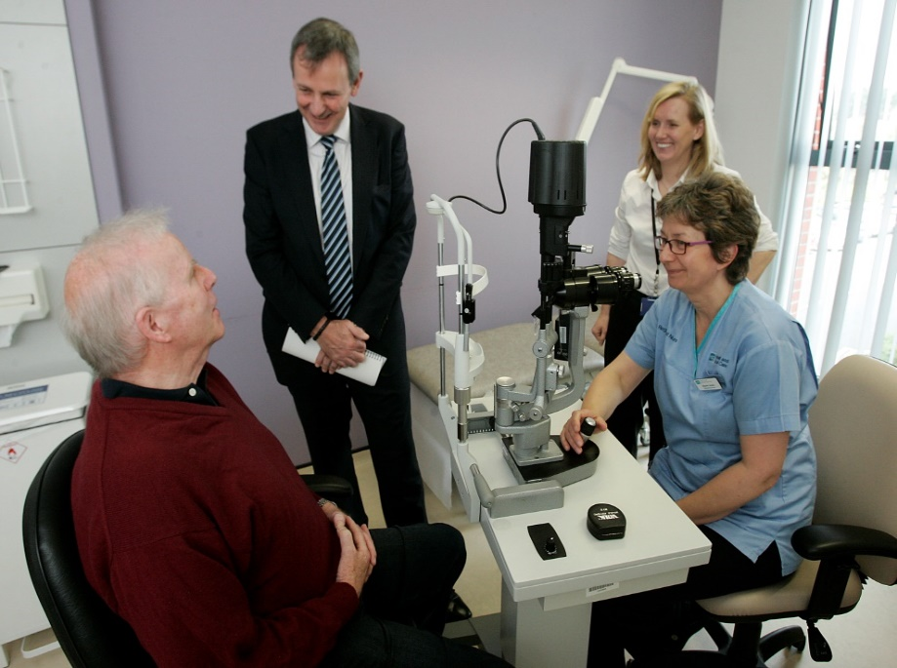
The Team
Investment in and Modernisation of Glaucoma Service (BHSCT)
MDT Team
Ophthalmic Technicians
Virtual Imaging & Diagnostic Testing
Consultant-led Virtual Assessment
Patient Centred

Slide 15
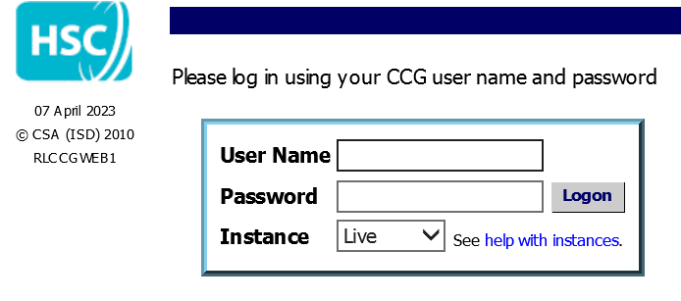
For ‘OHT’ the needs
were…..
The solution to assist was….
A partnership approach
A new relationship between the HSC Trusts and Primary Care
A sustainable service model to support care focused on patient profile, clinical needs and outcomes
A model which supports clinicians in the delivery of care recognising their skills, capability and value

Slide 16
‘Strength in Numbers’ – The Primary Care Optometry Contribution
We have delivered aligned to DoH strategy and policy
We have ~2,000 patients now discharged to primary care REGIONALLY for ANNUAL REVIEWS within a sustainable model of care which can support growth
Service expanded with now 52 optometry practices participating and 60 Optometrists engaged in the Glaucoma ECHO Knowledge Network
Positive relationships – ‘a genuine Win Win’
Award Winning
EVERYONE INVOLVED BECAME A LEADER AND A LEARNER

Slide 17
The “Acute Eyecare” Pathway
Secondary Care
Eye Casualty
Belfast & L/Derry
10 units (24 hours)
10 minor injuries units
Primary Care
265 practices (~762 optometrists)
38 ‘IP-qualified’ Optometrists
317 GP practices
525 Pharmacies

Slide 18
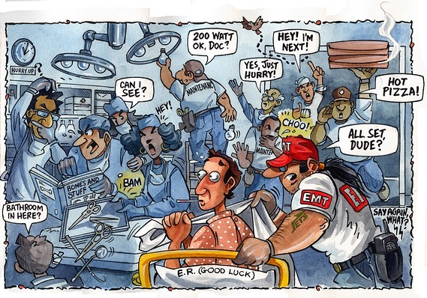
Pre 2018 -Belfast Trust Eye Casualty
The issues……..
Walk in service – crowded, variable by time of day, day of week, weather
Staff morale was low (Staff Questionnaires, Dr Callum Gray)
There was no HSC-funded Primary Care Optometry “Urgent Eye” Service
Many patients did not have an urgent eye condition

Slide 19
Attendance at Eye Casualty Belfast Trust Pre/Post NI PEARS
2017 (1170 px/month)
2019 (1293 px/month)
Other/ED 8%
GP
13%
Self
51%
Optometrist
20%
Optometrist
24%
Data: Audits 2017 and 2019 Simon Bond, Katie Graham, Deirdre Burns, Nic Cotton, Suhair Twaij, David Armstrong (BHSCT Eye Casualty)

Slide 20
Telephone first & appointment
Jan 2021 - 549 px/month
744 patients per month (average figures)
Data: Dr Deirdre Burns, BHSCT Eye Casualty Service Evaluation, Jan 2021
Notes:
First thing to notice– monthly attendance numbers had over halved

Slide 21
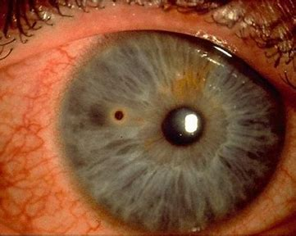
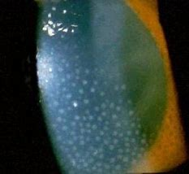
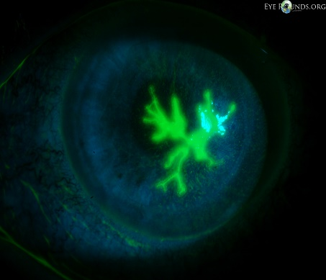
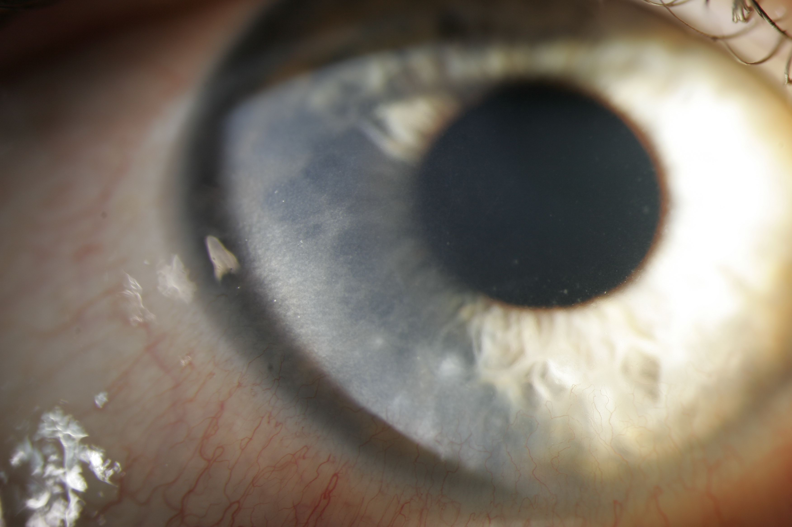
NI PEARS “PLUS” Pilot by Belfast Trust Eye Casualty & Primary Care Optometry
PILOT is restricted to 4 conditions:-
Superficial Foreign Body Unilateral AAU Dendritic Ulcer Marginal Keratitis
Commenced 24th April 2023 – Belfast Trust Eye Casualty catchment area (19 IP optometrists).
Treatment by community “IP” optometrists followed College of Optometrists CMGs (Clinical Management Guidelines)
Exclusions to NI PEARS PLUS
Exclude all contact lens wearers with red/painful eye(s)
Children under age 5
Patients within 6 weeks on intra-ocular surgery

Slide 22
Numbers Attending Eye Casualty, Belfast HSCT
N.I PEARS
Telephone First
No. of Patients/Month
CCG eReferral
COVID 19
PEARS PLUS PILOT

Slide 23
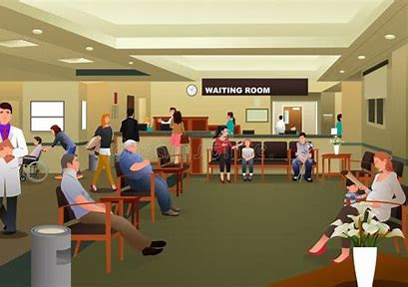

Slide 24
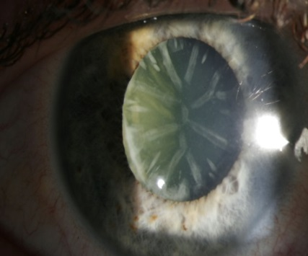
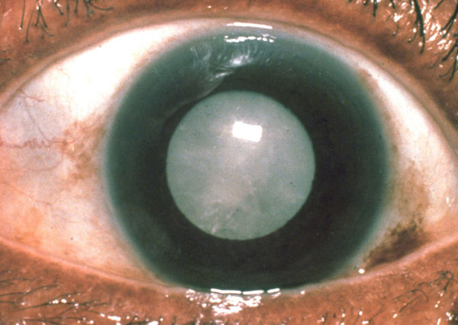
The Cataract Pathway……Why Cataract?
Most common elective surgical procedure worldwide
Safe, effective procedure
10% of IPDC waiters are for ophthalmology
Ranked high in ‘quality of life’ change for patients

Slide 25
Royal College of Ophthalmologists Calculator Population & Cataract 10 year predictions

Slide 26
This is large scale change, and LCS involves people…..
We cannot change by:
Changing structures alone
Changing processes alone
Changing behaviours alone
MATURITY
SYNERGY
Implementation
Planning
DISRUPTION

Slide 27
Southern Trust DPU Run Times

Slide 28
Another number….. The ‘Degree of Surgical Difficulty’ (DSD)
The impact of case complexity (degree of surgical difficulty - DSD) continues to undermine high flow lists, particularly at MUH and STH where theatre run time are generally restricted to 210 minutes.
Early analysis suggests that the majority of patients on the surgical waiting list are now complex (DSD3+) with this impacting on theatre throughput and efficiency; this appears most acute at STH & Downe sites, but may be across all sites.

Slide 29
Significant achievement
Number of patients waiting over one year on the surgical waiting list
March 2021 3,707
Sept 2023 282
Significant Issue
The impact of restricted funding for IS/WLI into
2023/24 will undermine performance as support from the Independent Sector is discontinued and the demand-capacity gap increases

Slide 30
Acknowledgements
BHSCT Eye Casualty Team (Audits: 2017, 2019, 2021, 2023) – Mr D Armstrong, Dr D Burns, Dr Katie Graham, Deirdre Burns, Dr Nic Cotton, Dr Suhair Twaij
BHSCT Glaucoma Service Team – Dr A Knox, Dr M Napier, Prof A Azuara Blanco
SPPG – Performance, Safety and Service Improvement Team

Slide 31
Outcomes
How to avoid hitting the target but missing the point…

Slide 32
People-centred, outcomes-focused, collaborative.
Progress over perfection
Pursue efficiency and consistency
Build resilience
Work within collaborative frameworks
Share outcomes: reporting & regular feedback cycles

Slide 33
In closing…
Thank you.
Raymond.curran@hscni.net

