Slide 1
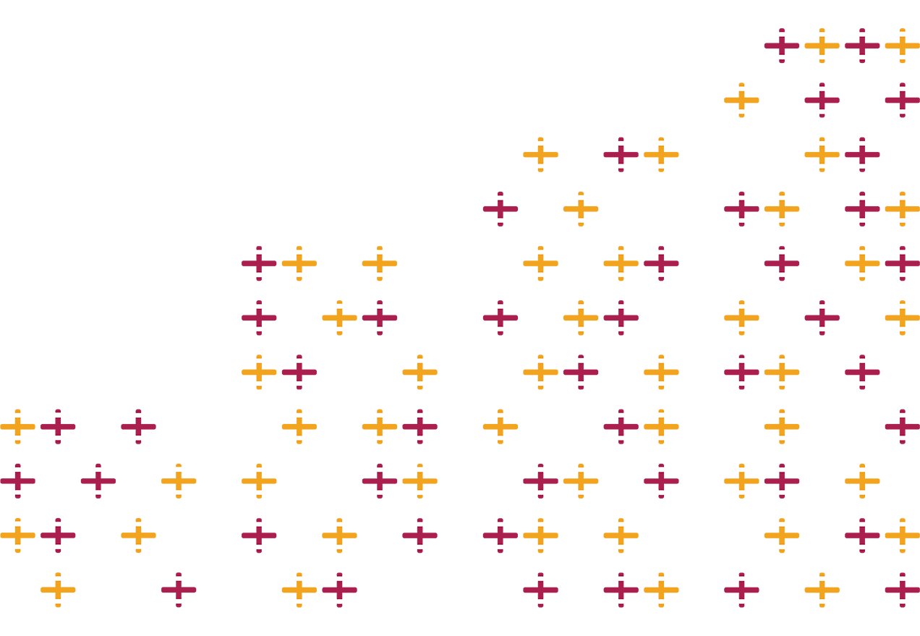
STRENGTH
HFMA Northern Ireland Annual Conference 2023
IN NUMBERS

Slide 2
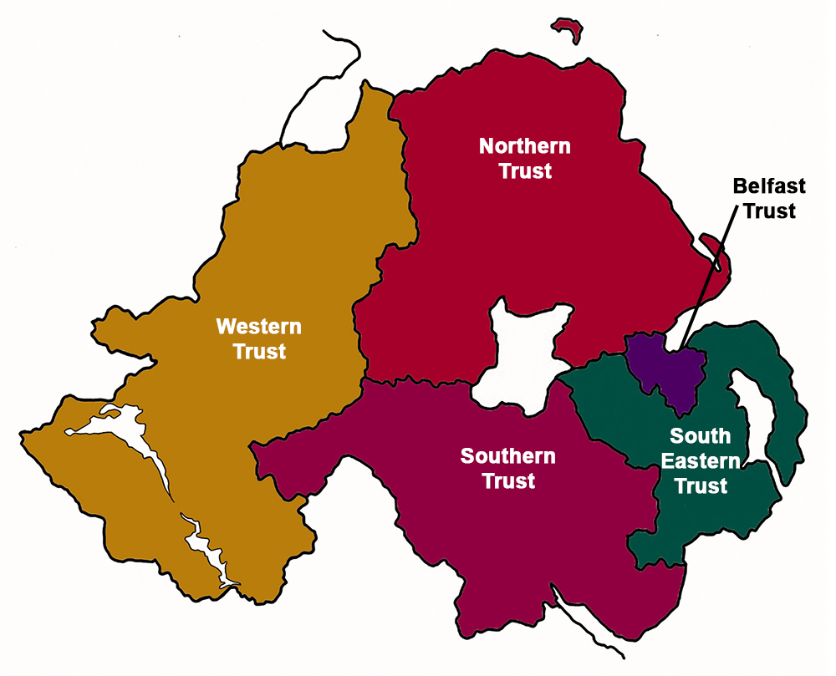
Where on earth am I now??
Notes:
5 areas.

Slide 3
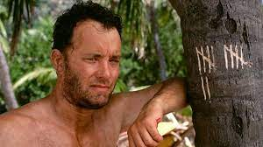
#13/13…

Slide 4
Sheffield 1990’s

Slide 6
Public expectations
Productivity
Outpatient transformation
Workforce challenges
Record waiting lists
Covid?
GIRFT
Capital
Infrastructure?
Quality scandals
Strike action
Social care

Slide 7
The Northern Ireland Experience
1.Record numbers waiting for elective care, and record waiting times
2.Cancer performance extremely challenged(all time low?)
3.ED performance under enormous pressure
4. 14% growth in workforce since March 2018
5.Reducing numbers of GP practices and changing demographic of general practitioners – not all of whom are choosing to work full time
Notes:
Check the room! Amongst friends - Check which sectors have balanced plans. How many ICS dofs are in the room?

Slide 8
Temperature check……
1.Who has got a plan with a hole in it?
2.Who is NOT using any balance sheet or non recurrent flexibility to deliver their 23/24 plans?
3.Who is on plan at M07?
4. Who expects to be on plan at M12? Is anyone declaring off plan at M12 as part of the reset exercise?
5.Who thinks they will exit 23/24 with a recurrent underlying position worse than the one they entered the year with?
Notes:
Check the room! Amongst friends - Check which sectors have balanced plans. How many ICS dofs are in the room?

Slide 9
1. Re-asserting the role of finance staff In delivering effective and sustainable patient services
2. Using financial knowledge to enable system working
3. Widening the HFMA’s network as part of our picking up the pace strategy 2022 to 25

Slide 10
Re-asserting the role of finance staff

Slide 11
GRIP & CONTROL…..THE BASICS

Slide 12
Using financial knowledge to enable system working

Slide 13
Notes:
HFMA constantly looking to any source of information to help as a tool for the service – but e also need to be using the model hospital and GIRFT data as much as possible. No substitute for good quality local benchmarking and intelligence to stimulate the debate.

Slide 14
Collaboration
The Model Health System
2021/22 National Cost Collection Data Publication
Getting It Right First Time (GIRFT)
Notes:
Collab between providers and within and across all boundaries – my experience in the Humber is good.

Slide 15
Picking up the pace The HFMA’s 2022 to 2025 strategy

Slide 17
Notes:
And don’t forget the awards!

Slide 18
In closing…
Its tough out there and unlikely to get any easier anytime soon.
Strength in numbers seems even more relevant as we enter the final phas epof the year – we have to stick to what we are good at, look after ourselves, our teams and our patients.
Through the consistent and professional application of the numbers we will help drive the solutions that our systems need.

Slide 19
Thank you.

